Slide 1

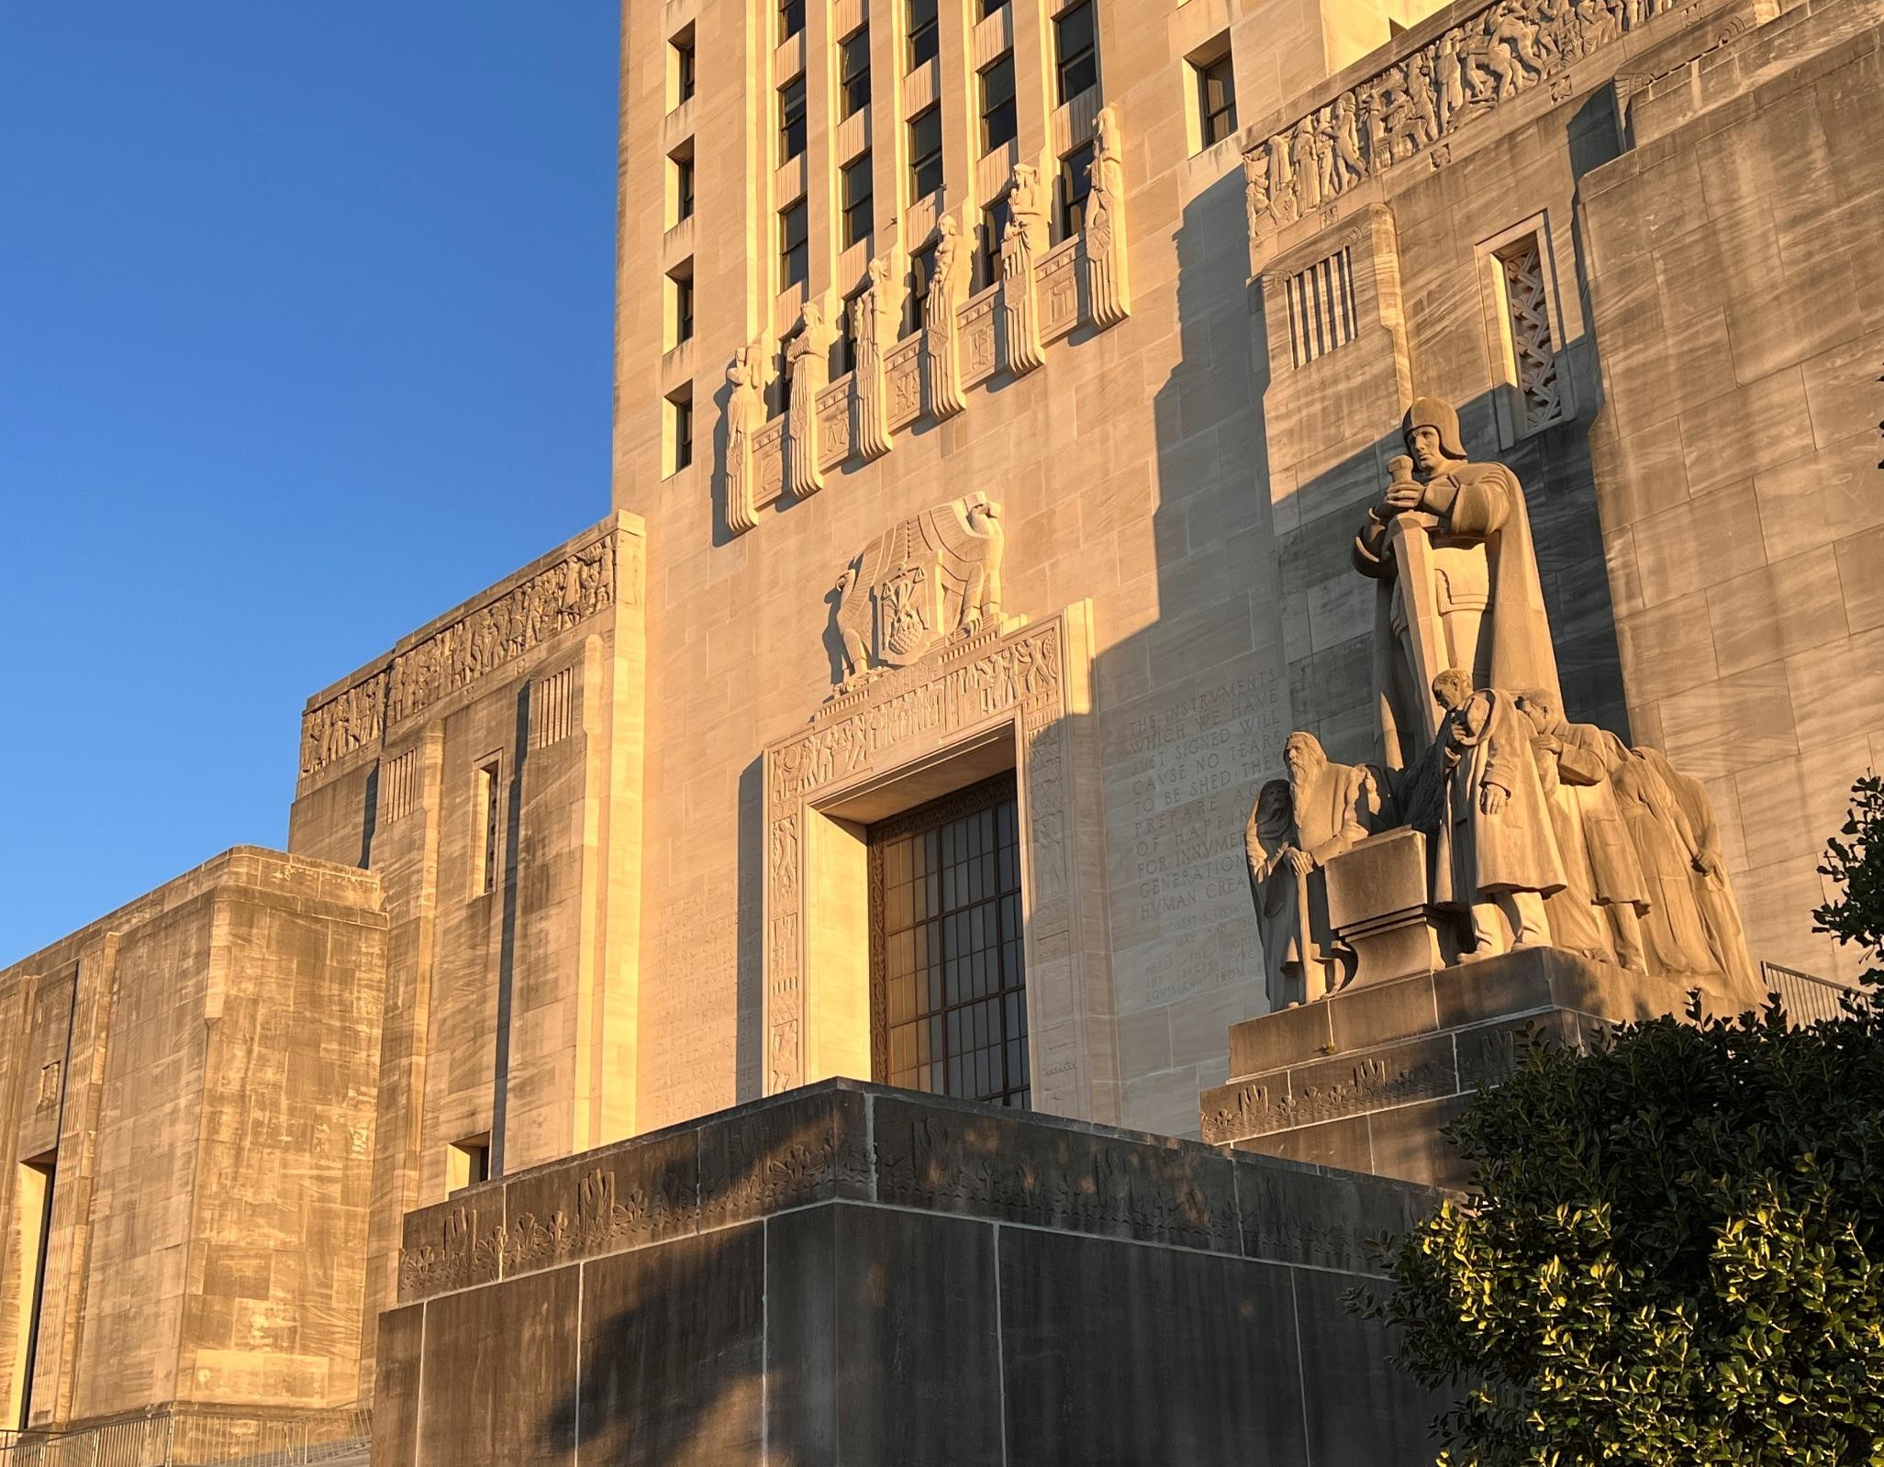
ROGER E. HUSSER, JR, P.E.
A S S I S T A N T C O M M I S S I O N E R
DI VISION OF ADMINIST RAT ION
M A T T H E W H . B A K E R
A R C H I T E C T / D I R E C T O R
FACILIT Y PLANNING & CONTROL
STAT E
O F T H E
STAT E
2025 UPDATE ON CAPI TAL OUTLAY AND FACILI T Y PLANNING & CON TROL

Slide 2

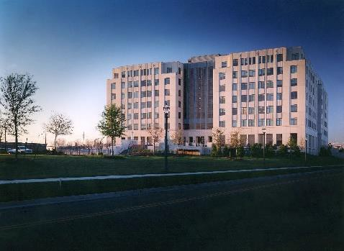
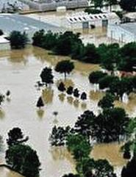
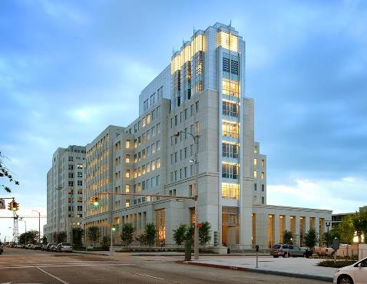
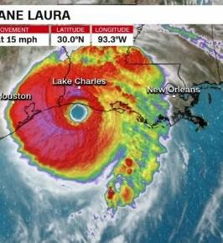
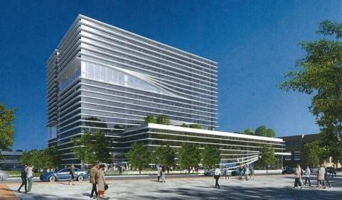




CAPITAL OUTLAY BILL
  DEVELOPMENT AND ENACTMENT
  EXECUTION
PROVIDE ADMIN & OVERSIGHT OF CAPITAL CONSTRUCTION PROGRAM
  STATE PROJECTS AND NON-STATE PROJECTS
ADMINISTER VARIOUS STATEWIDE PROGRAMS
  REAL ESTATE LEASING AND PROPERTY MANAGEMENT
  HAZARDOUS MATERIALS ABATEMENT
  ENERGY CONSERVATION & CODE COMPLIANCE
  BUILDING CODE / ADA COMPLIANCE FOR STATE-OWNED FACILITIES
  ROOFING AND PREVENTATIVE MAINTENANCE
  MAJOR REPAIRS PROGRAM FOR STATE-OWNED FACILITIES
  ADMINISTER STATE-WIDE SELECTION BOARDS
    (ARCHITECTS, ENGINEERS, LANDSCAPE ARCHITECTS)
  DEMOLITION OF STATE-OWNED FACILITIES
DIRECT DISASTER RECOVERY EFFORTS FOR STATE-OWNED FACILITIES
The Role of Facility Planning and Control

Slide 3
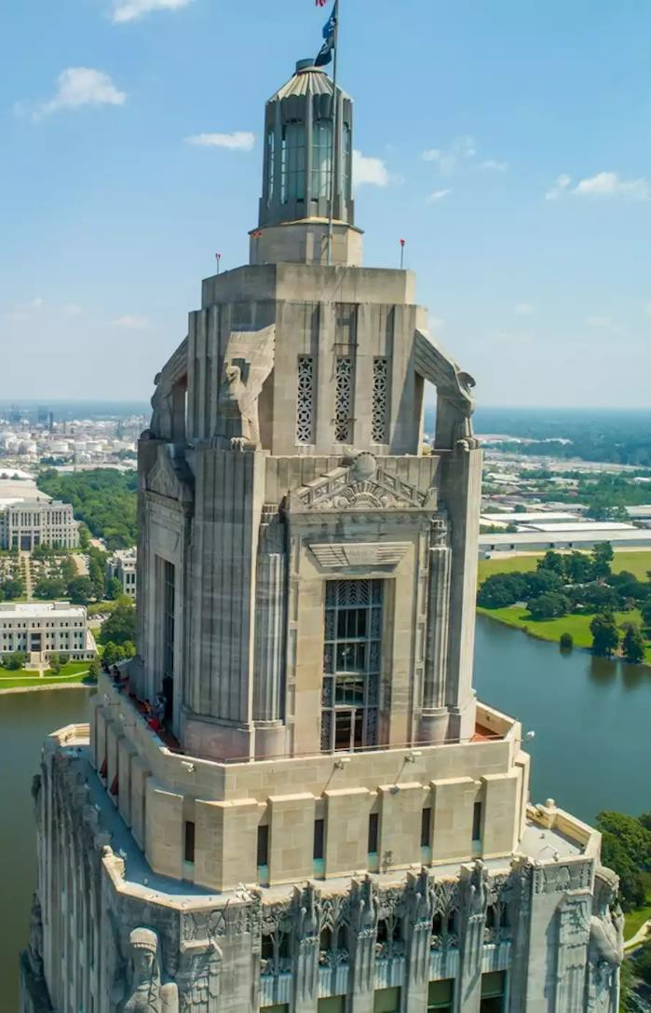
STATE AGENCIES INCLUDED IN THE CAPITAL OUTLAY BILL
(Agencies in Yellow are Administered by FP&C)
HIGHER EDUCATION
DIVISION OF ADMINISTRATION
DEPARTMENT OF PUBLIC SAFETY AND CORRECTIONS
LOUISIANA DEPARTMENT OF HEALTH
CRT: OFFICE OF STATE MUSEUMS & OFFICE OF STATE PARKS
DEPARTMENT OF VETERANS AFFAIRS
DEPARTMENT OF WILDLIFE AND FISHERIES
SECRETARY OF STATE
NEW ORLEANS CITY PARK
NAVAL WAR MEMORIAL COMMISSION
DEPARTMENT OF TRANSPORTATION AND DEVELOPMENT (DOTD)
COASTAL PROTECTION AND RESTORATION AUTHORITY (CPRA)
DEPARTMENT OF MILITARY AFFAIRS
LOUISIANA STADIUM AND EXPOSITION DISTRICT
Capital
Outlay
Bill

Slide 4
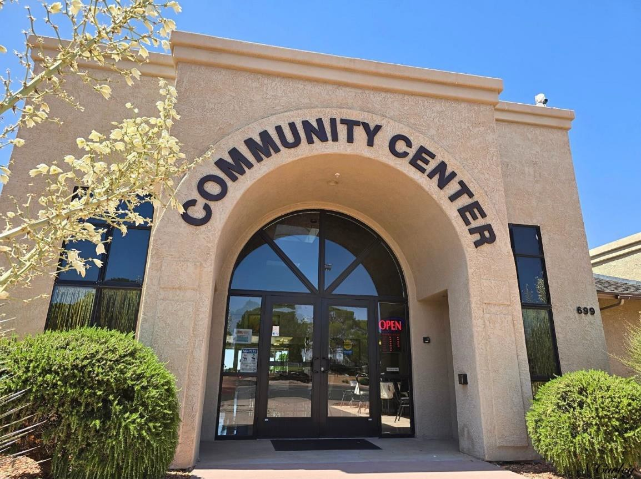
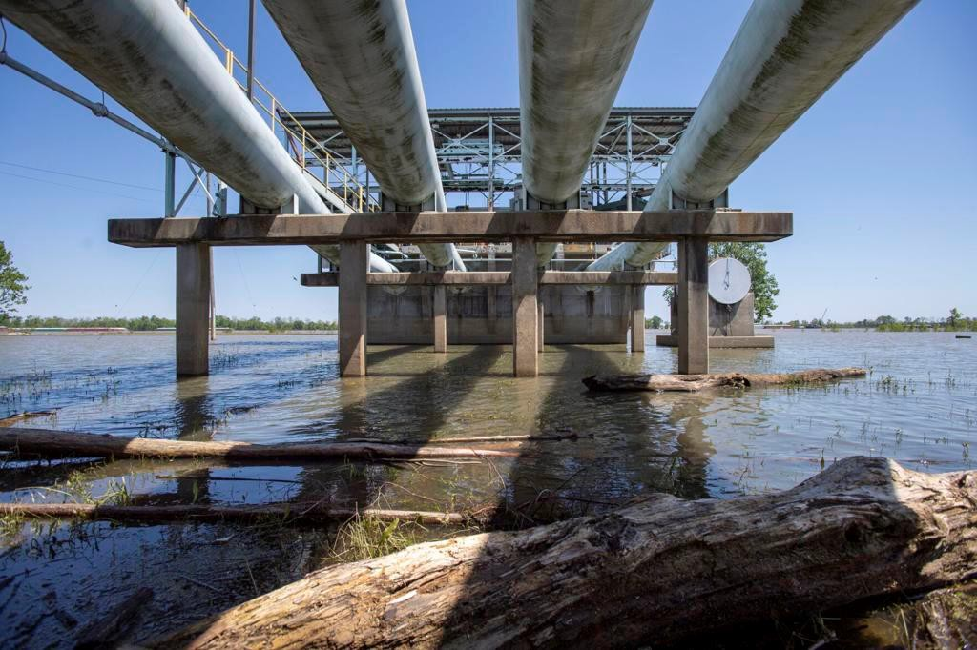
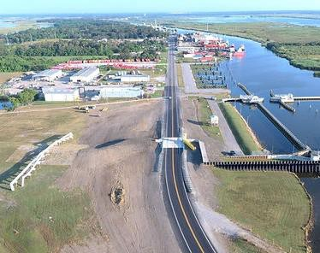
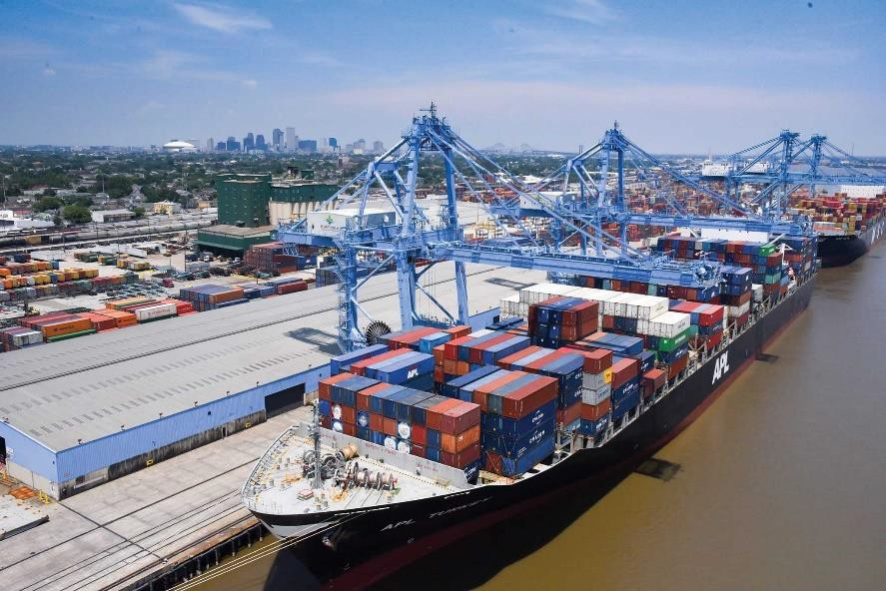
NON-STATE ENTITIES INCLUDED IN THE CAPITAL OUTLAY BILL
MUNICIPALITIES
PARISHES
LEVEE DISTRICTS
PORTS
OTHER POLITICAL SUBDIVISIONS OF THE STATE
NON-GOVERNMENTAL ENTITIES
Capital
Outlay
Bill

Slide 5
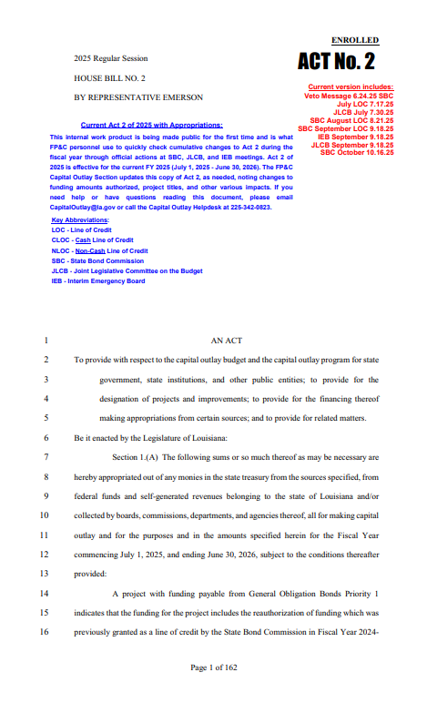
CURRENT STATUS OF THE CAPITAL OUTLAY BILL
2025 CAPITAL OUTLAY BILL (HB2)(ACT 2) *CURRENT
  1971 REQUESTS RECEIVED
  775 PROJECTS IN THE ORIGINAL BILL
  937 PROJECTS IN THE FINAL BILL
  ORIGINAL VERSION OF BILL: $11 BILLION
  FINAL VERSION OF BILL: $12.6 BILLION ($11.6B LAST YEAR)
2026 CAPITAL OUTLAY BILL (HB2)(ACT TBD) *FUTURE
  1621 TOTAL REQUESTS RECEIVED
  369 STATE PROJECT REQUESTS
  1,252 NON-STATE PROJECT REQUESTS
Capital
Outlay
Bill

Slide 6
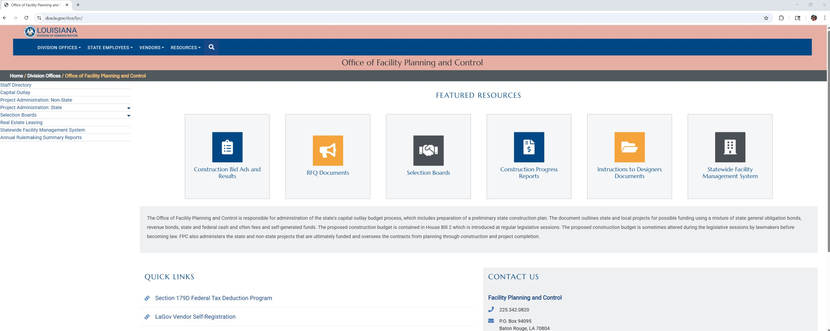
TO ACCESS THE BILL WITH APPROVED APPROPRIATIONS SHOWN::
VISIT: https://www.doa.la.gov/doa/fpc/
Click “Capital Outlay” in the right-hand menu.
Capital
Outlay
Bill

Slide 7
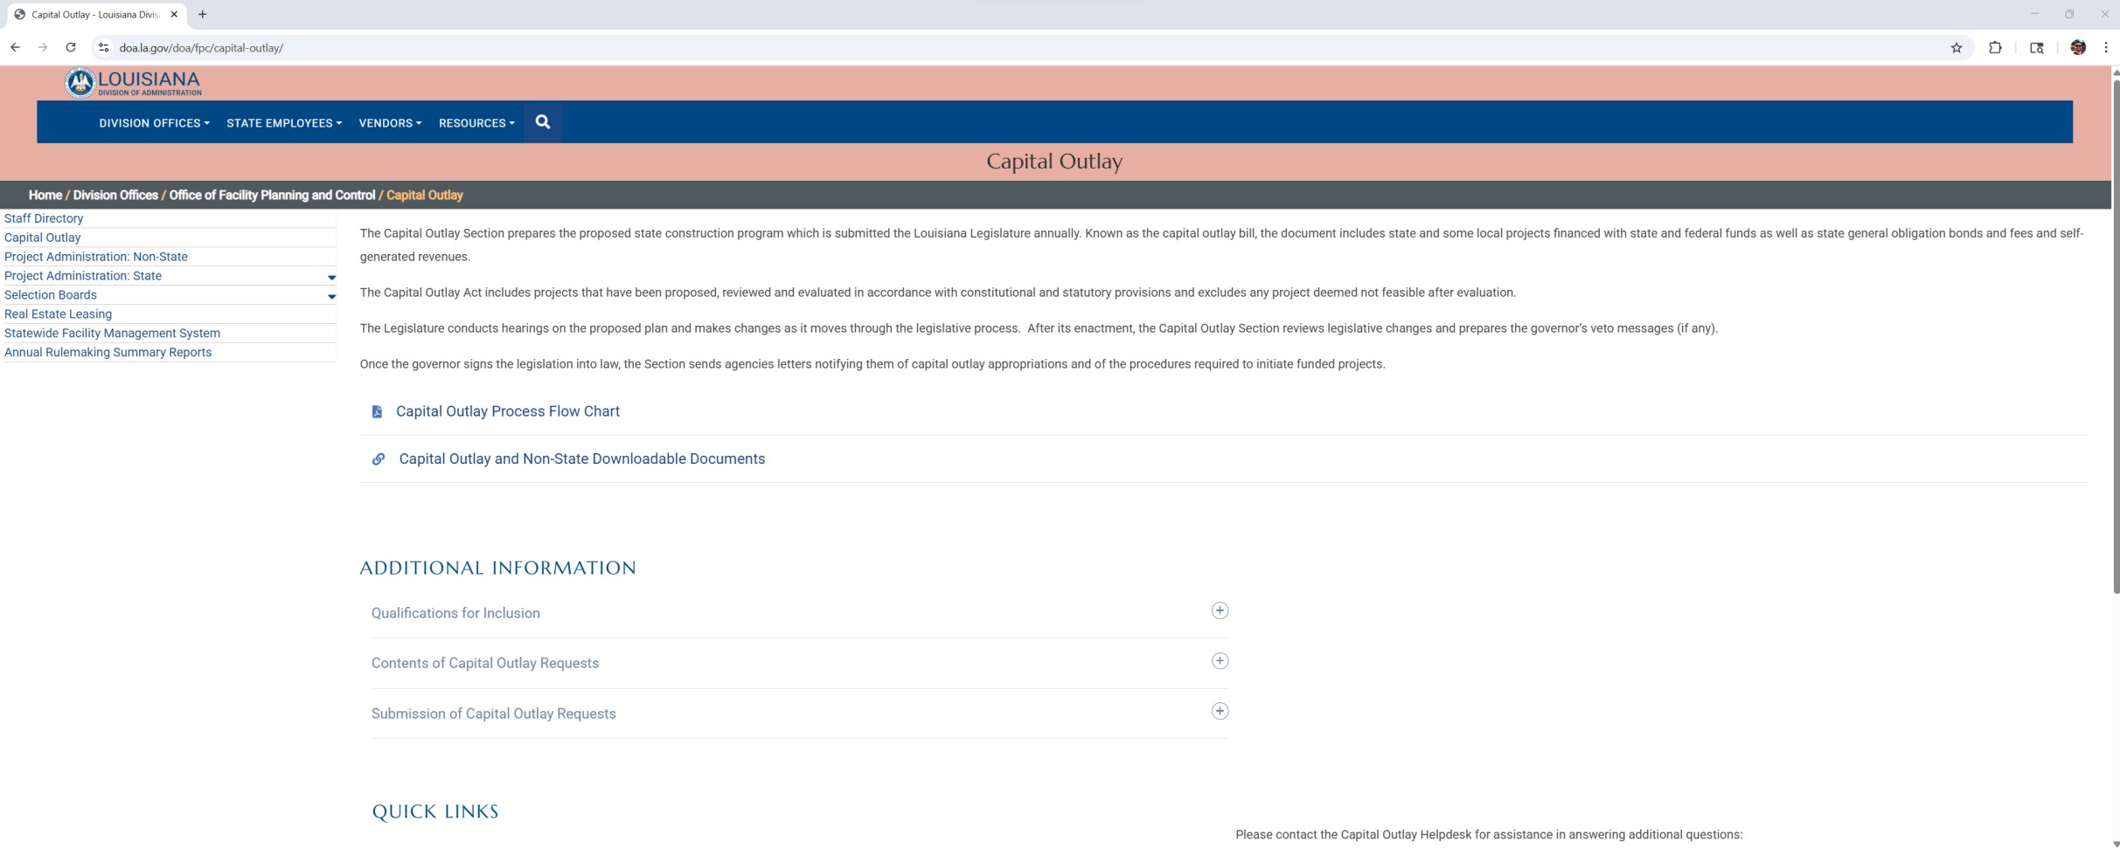
TO ACCESS THE BILL WITH APPROVED APPROPRIATIONS SHOWN::
Click “Capital Outlay and Non-State Downloadable Documents”
Select “Act 2 of 2025 with Approved Appropriations”
Capital
Outlay
Bill

Slide 8
TO ACCESS THE BILL WITH APPROVED APPROPRIATIONS SHOWN:
Click “Capital Outlay and Non-State Downloadable Documents”
Capital
Outlay
Bill

Slide 9
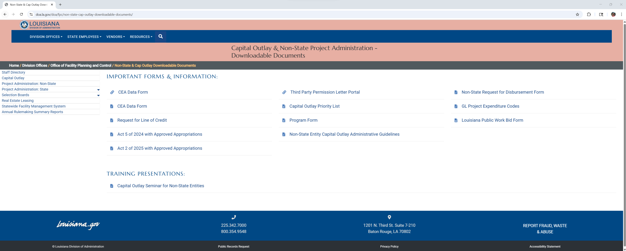
TO ACCESS THE BILL WITH APPROVED APPROPRIATIONS SHOWN:
Select “Act 2 of 2025 with Approved Appropriations”
Capital
Outlay
Bill

Slide 10
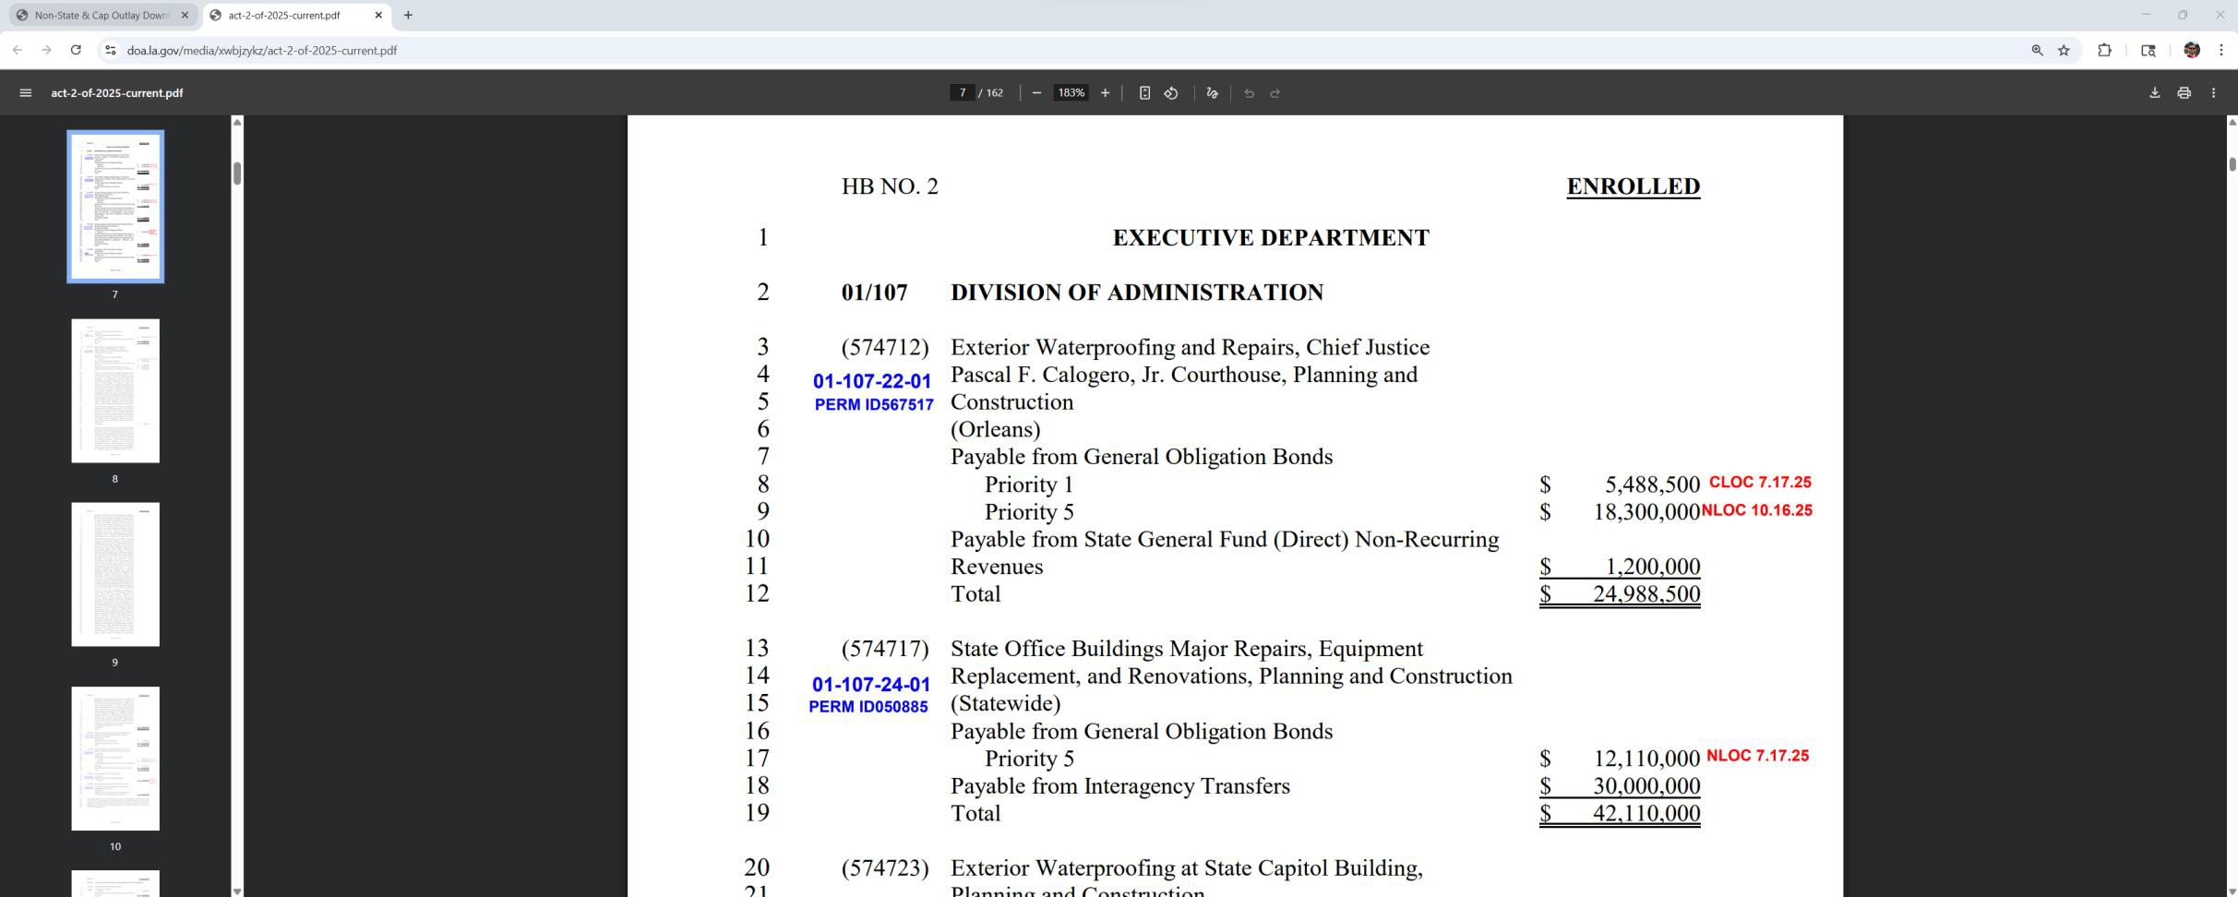
TO ACCESS THE BILL WITH APPROVED APPROPRIATIONS SHOWN:
Text shown in RED indicates lines of credit that have been approved by the State Bond Commission:
Capital
Outlay
Bill

Slide 11




Other Administering Agencies
DOTD
FP&C State
FP&C Non-State
4.4%, 4%
FP&C Non-State - 36.6%
DOTD - 26.8%
FP&C State - 32.2%
*2025
Capital Outlay Project Administration

Slide 12
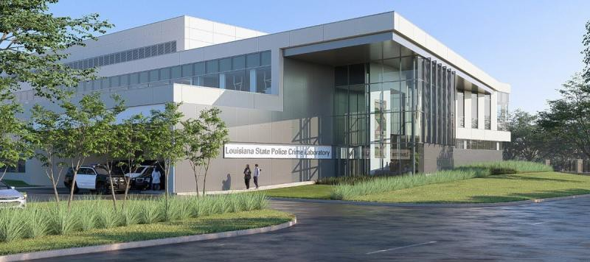
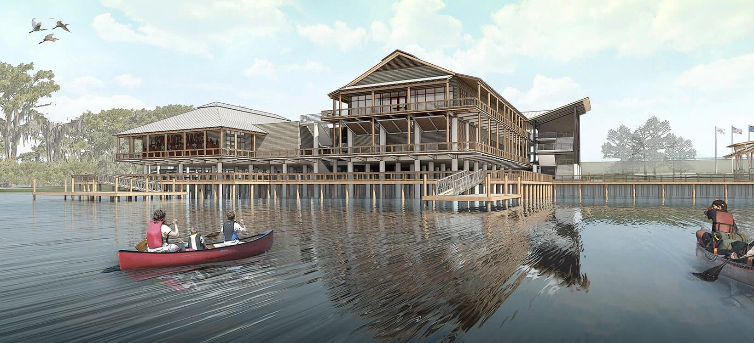
CURRENT PROJECTS UNDER THE MANAGEMENT OF FPC:
1,317 TOTAL PROJECTS
  397 UNDER CONSTRUCTION
  920 IN PLANNING & DESIGN
377 STATE PROJECTS ($3.2 BILLION)
  157 UNDER CONSTRUCTION ($1.3 BILLION)
  220 IN PLANNING & DESIGN
940 NON-STATE PROJECTS
  240 UNDER CONSTRUCTION
  700 IN PLANNING & DESIGN
FP&C Project Portfolio

Slide 13
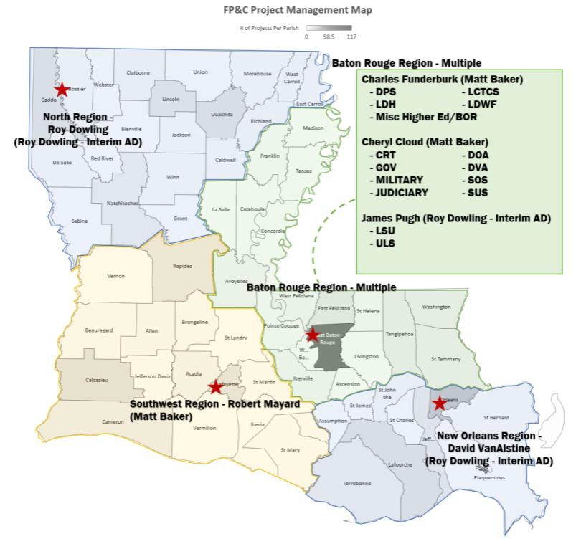

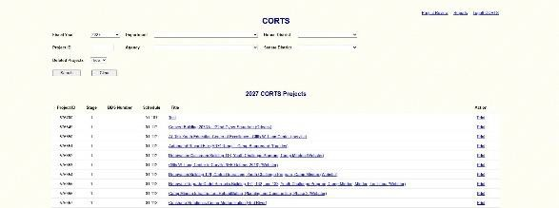
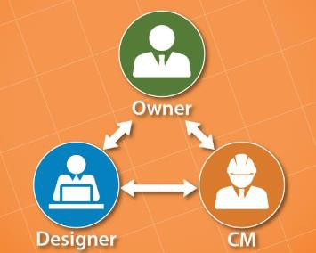
Focus on ensuring the public dollars are spent appropriately :
* Our mission is also to deliver each project with maximum e ficiency and e fectiveness.
Regional project management plan – Four Regions/Offices
Construction Manager at Risk (CM@R) Changes
Addressed salaries and utilizing project management services
  Civil Service action to address salaries – improve recruitment
  Staff augmentation and project specific services
Delegation of project management to entities
Development of Capital Outlay Bill more attuned to cash flow needs
Development of 3rd Party Commissioning & Energy Modeling requirements.
Created a Business Analyst position to analyze and improve processes and procedures
Implementation of enterprise project management software – Trimble Unity Construct
Redevelopment of the state’s eCORTS system.
Consolidation of the Instructions to Designers and Procedure Manual.
  Development of CMaR specific Instructions to Designers.
  Development of a comprehensive training plan for Project Managers
FP&C INITIATIVES AND CHANGES

Slide 14
Total FPC Project Expenditures
$800,000,000
$728,928,282
$700,000,000
$401 m (122%) increase
$600,000,000
$328 m average
$500,000,000
$517,901,126
$437,244,191
$406,290,136
$400,000,000
$365,277,153
$300,000,000
$283,117,644
$266,717,886
$214,452,420
$200,000,000
$100,000,000
$0
FY18
FY19
FY20
FY21
FY22
FY23
FY24
FY25
Project Expenditures – Measures of Success

Slide 15
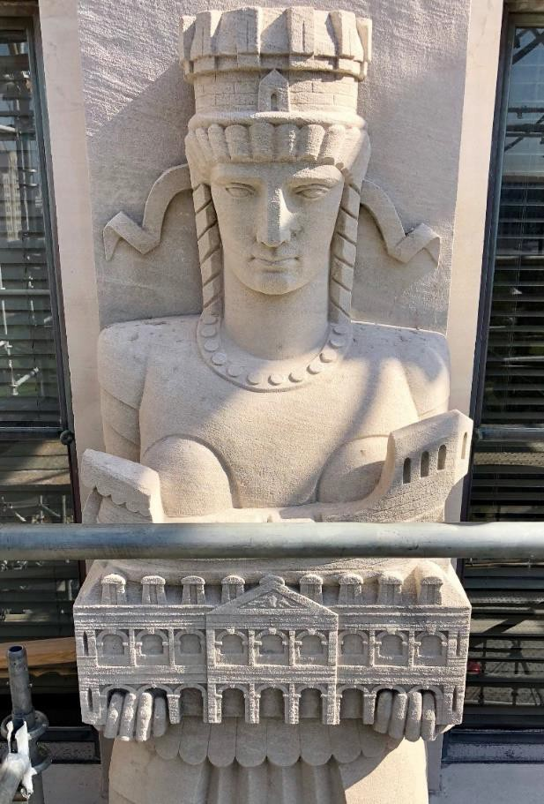
HB 312 – Architects/Engineers – selections and fees
HB 347 – change order approvals from $100,000 to $250,000 HB 566 – Job Order Contracting for Higher Education
SB 164 – Public Bid Law/Contractor Payment Training SB 166 – Improvement of Contractor Payments/Software SR 69 – Creates Public Projects Task Force
Key Changes to Law

Slide 16
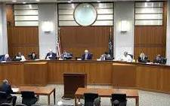
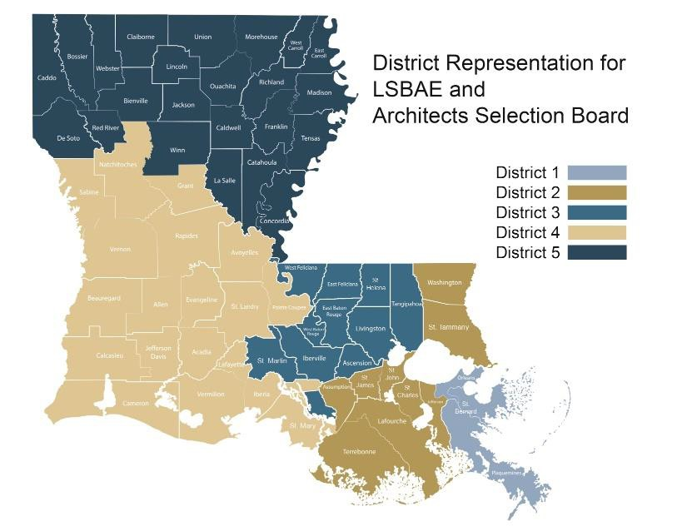
FOR FPC CONTRACTED PROJECTS ONLY:
(excludes DOTD, LSED, CPRA, LED, OCD & Legislative Budgetary Control Council)
State Selection Board Contracts*
(*for projects AFC of $1,000,000 or greater)
The Louisiana Architects Selection Board
The Louisiana Engineers Selection Board
The Louisiana Landscape Architects Selection Board
(R.S. 38:2311 Identifies the committee make up and selection criteria)
*Does not apply to “non-state” entities
Designer Selection

Slide 17

FOR FPC CONTRACTED PROJECTS ONLY:
(excludes DOTD, LSED, CPRA, LED, OCD & Legislative Budgetary Control Council)
Direct Appointment contracts
(*for projects with an AFC of less than $1,000,000)
FPC MAINTAINS A LIST OF AND CONSIDERS NUMEROUS FIRMS FOR DIRECT APPOINTMENTS
Considerations for the selection of firms for direct appointment contracts:
Specific experience / qualifications
Hudson initiative (small businesses)
Veteran owned / disabled veteran owned
Proximity to the site
Number of projects with fpc in the last 4 years
Designer Selection

Slide 18





Act 751 intends to fund the $2 billion higher education deferred maintenance backlog
$25 MILLION PROVIDED THIS FISCAL YEAR, $75 MILLION LAST YEAR
All projects are delegated to the universities to manage
Generally smaller projects
Could include larger renovation type projects in future years
A Study is currently underway to determine the scale and prioritization
OF DEFERRED MAINTENANCE AT HIGHER EDUCATION FACILITIES STATEWIDE, ALLOWING
FOR STRATEGIC APPROPRIATIONS OF FUNDING IN LATER YEARS.
ACT 751 (HIGHER EDUCATION DEFERRED MAINTENANCE)

Slide 19
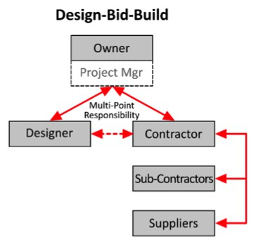
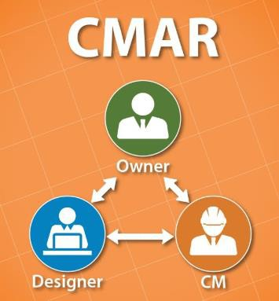
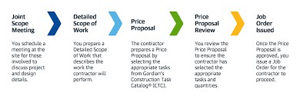
Design / Bid / Build (DBB)
364 Active FP&C State Projects
Advertised in the official journal and latap
Construction Manager at Risk (CM@R)
13 Active FP&C State Projects
Advertised in the official journal, latap and fpc website
Selection criteria and committee defined in statute
Job Order Contracting (JOC)
0 Active State Projects
Selection Process defined in statute (Act 88 of 2025)
Applicable to Higher Education Deferred Maintenance Projects
TITLE 38 (CONSTRUCTION DELIVERY METHODS)

Slide 20
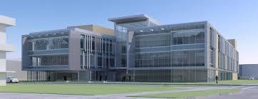
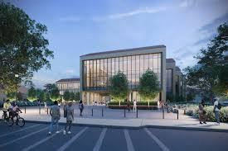
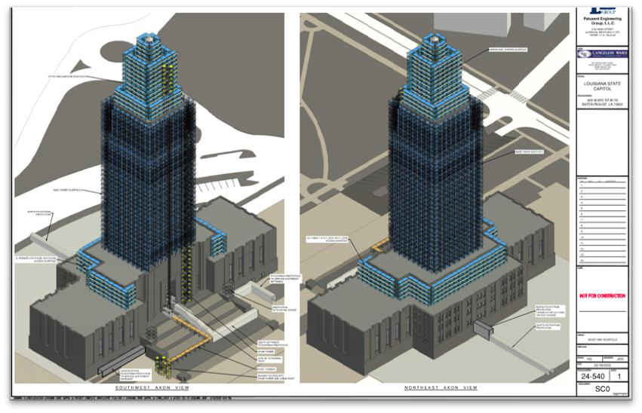
Statutory requirements:
  Public entities have flexibility to choose at $15 m or greater
  Requires legislative approval from $5 m to $15 m
  Design cannot exceed 30% prior to CM@R Selection
FP&C’s considerations for using CM@R:
  Large projects
  Complex/Phased projects
  Projects that benefit from early start/Schedule
Criteria for CM&R selection in RFQ’s:
  History, Organization, Financial Condition of Proposer
  Qualifications and Staffing Plan
  Approach and Methodology
  Past Performance and Experience on Similar Projects
CONSTRUCTION MANAGER AT RISK

Slide 21
WHAT NEW PROJECTS ARE COMING OUT???
MONITOR HB2 DURING LEGISLATIVE SESSION
  “CASH” SOURCES GENERALLY BECOME AVAILABLE JULY 1, ALONG WITH REAUTHORIZED
PRIORITY 1 or 2 AT JULY BOND COMMISSION
MONITOR BOND COMMISSION AGENDAS INTO THE FALL FOR CASH LINES OF CREDIT
  NEW PRIORITY 1 or 2 GENERALLY BECOMES AVAILABLE IN SEPTEMBER/OCTOBER WITH APPROVAL BY THE BOND COMMISSION
MONITOR SELECTION BOARD AGENDAS
  ARCHITECT SELECTION BOARD, ENGINEER SELECTION BOARD, LANDSCAPE ARCHITECT SELECTION BOARD (SIGN UP FOR THEIR NOTIFICATIONS)
MONITOR LaTAP/NEWSPAPERS/FPC WEBSITE FOR ADVERTISEMENTS FOR BIDS AND CM@R RFQ’S
VISIT WITH ASSISTANT DIRECTORS AND SENIOR MANAGERS AT FP&C
PROJECT UPDATE / OUTLOOK

Slide 22
To find projects included in the current capital outlay bill (hb2): Visit the Legislative Website:
WWW.LEGIS.LA.GOV/LEGIS/HOME
Use Dropdown on “Bills – 2024 Regular Session”
Search by Instrument: Dropdown “HB” and fill in “2”
Dropdown “Text” and “HB2 Act”
At This Point HB2 Will be Displayed
“New” Projects in the bill Are Generally:
  Priority 1 or 2 with Associated Priority 5
  Other/Cash Means of Financing with Priority 5
PROJECTS INCLUDED IN THE CURRENT HB2

Slide 23
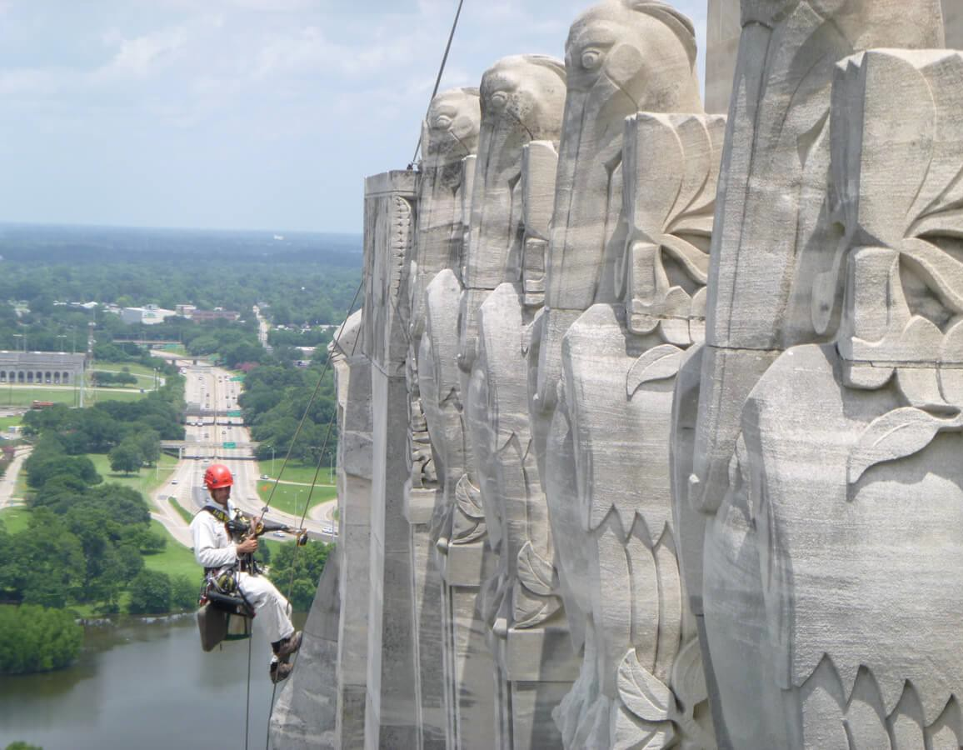
ROGER E. HUSSER, JR, P.E.
A S S I S T A N T C O M M I S S I O N E R
DI VISION OF ADMINIST RAT ION
M A T T H E W H . B A K E R
A R C H I T E C T / D I R E C T O R
FACILIT Y PLANNING & CONTROL
STAT E
QUESTIONS?
MAT T HEW. BAK ER@LA .GOV
( 22 5 ) 3 4 2 - 08 4 9
O F T H E
STAT E
2025 UPDATE ON CAPI TAL OUTLAY AND FACILI T Y PLANNING & CON TROL

