Slide 1



Louisiana Department of Transportation and Development
Project Outlook
2025
November 2025

Slide 2

Today’s Topics
Legislative and Agency Priorities
Initiatives and Contracting
LADOTD will advance and strengthen transportation for our state with greater transparency and accountability, driving economic development and growth across Louisiana.
Notes:
Reshape how DOTD serves the people of LA
by enhancing internal & external operations and communication

Slide 3
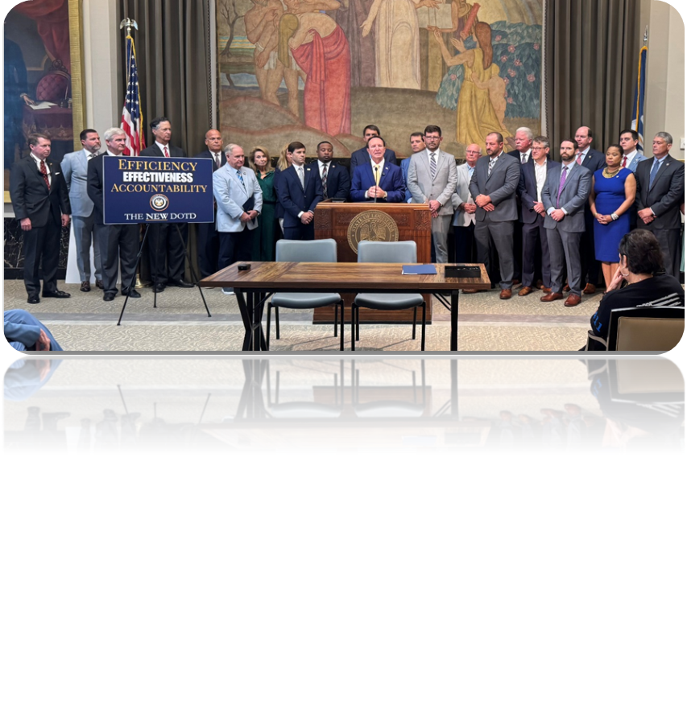
General Priorities
Maintain the Existing System
  Focus on preservation - Road and Bridge
4-Mega Projects - Identified by Legislature
  Calcasieu Bridge
  I-49 S and I-49 N
  BR South Mississippi River Bridge
Will of Legislature
  In the form of dedicated funding

Slide 4
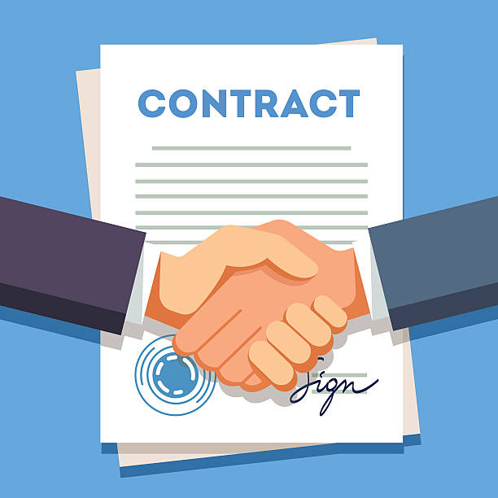

Key Initiatives and Consultant Contracting

Slide 5
PRIORITIZATION
Initiative Description
  This initiative modifies the processes for selecting projects to include in the annual Highway Priority Program.
  The goal is to ensure funding is allocated based on objective project assessments and that the HPP is consistently delivered annually, improving the reliability of published letting dates.
  The initiative will improve the Statewide Transportation Improvement Program processes to ensure they are transparent and effective for efficient project programming and delivery.
  This initiative aligns with the Strategic Improvement Plan’s Planning Core Area as it directly addresses concerns regarding a “fragmented and inconsistent prioritization of projects.”
Notes:
Remove bloat and over programming from letting list
Contemplate a formula based prioritization process
Consider consolidating programs, currently 48
5 year priority program

Slide 6
LPA PROGRAM
Initiative Description
  A comprehensive analysis of the current procedures and organizational structure is being conducted to identify opportunities to improve DOTD program oversight and project delivery while providing the LPAs with a more consistent, coordinated and consolidated program structure and improved processes and guidance.
  This initiative modifies Local Public Agency Program processes and the program and project delivery organizational structure​.
  This initiative assists in optimizing the agency’s operations in the Strategic Improvement Plan’s Policies and Procedures Core Area, which identified “unreliability in project delivery and letting” as a concern.
Notes:
Consider consolidating all LPA programs into one organizational unit
Consider outsourcing project management and maybe program management

Slide 7
CONSULTANT CONTRACT ADMINISTRATION
Initiative Description
  This effort looks to refine Consultant Contract Administration into a more agile and impactful process.
  Streamline operations and centralize key administrative functions, significantly reducing the administrative burden on project managers.
  Leverage technology for contract preparation and execution
  Implement electronic invoicing
Notes:
Automate contracting tasks, timing, and selection
consultant acquisition plan based on the 5 year program
Streamlined and standardized contract work effort calculations and negotiation
Consider centralized procurement of contracts
IDIQ based project delivery
Comprehensive Gen Eng Services contracts

Slide 8
PROJECT DELIVERY
Initiative Description
  Optimize project delivery by implementing a Project Delivery Network approach, which focuses on increasing coordination and collaboration among project team members through a system of defined activities.
  Implement WBS based project delivery plan
  Implement online project tracking and reporting
  This initiative enhances the Strategic Improvement Plan’s Policies and Procedures Core Area, which identified unreliability in project delivery and letting as a concern.
Notes:
PDN – optimized, defined and documented processes
WBS based project delivery plan
Implement online project tracking and reporting

Slide 9
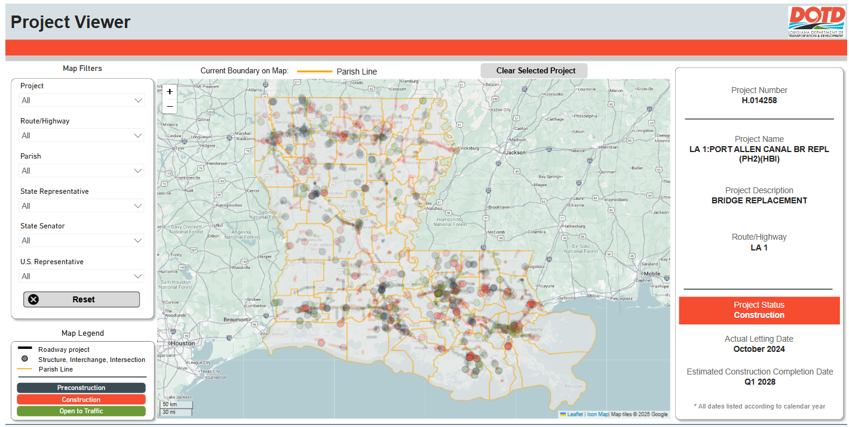

PROJECT REPORTING SYSTEM
Initiative Description
  Implement new interface and updated process for project schedule development and updates
  Develop project status and workload forecast report
  Build schedule templates based on current processes
  Perform regular schedule updates, review project status in dashboard

Slide 10
BRIDGE PROGRAM
Initiative Description
  This initiative will pursue innovative means to improve deficient bridges, enhance the program’s efficiency and streamline processes to ensure the long-term success of DOTD’s bridge preservation program.
  Louisiana is currently ranked 7th among all states with the highest percentage of bridges in poor condition.
  This initiative will outline recommendations and suggest efficiency improvements to streamline the bridge program, to optimize project scope and improve plan development efficiencies.
  Bridge bundling program to accelerate project delivery sent to OLHC.
Notes:
Off System bridge program will be bundled into locations of 3-5
Optimize site specific design
minimize roadway closures and construction timelines
box culverts
Utilization of precast element
Review of underutilized structure types
concrete arches

Slide 11
Engineering Priorities
Systematic efficiencies
Update Policies, Specifications and Standards
Workforce
Relationships
Notes:
consistency with and for staff
build and enhance relationships with internal and external parties
knowledge transfer internally and externally
Open and willing to listen to concerns, suggestions, recommendations of all, incl ACEC

Slide 12
Needs for Success
Workforce / Resources
  Pre-Construction and Construction
Innovations to reduce time or $
Opportunities
  More $ = More projects => More help
  Plan Development, Project Management, Program Management, Construction Oversight
Notes:
To meet expectations if there is an increase in $$.

Slide 13

Engineers,
as practitioners of engineering, are professionals who invent, design, analyze, build and test machines, complex systems, structures, gadgets and materials to fulfill functional objectives and requirements while considering the limitations imposed by practicality, regulation, safety and cost.
Notes:
Help DOTD do it’s job. Understand its roll and mission, with the citizens first; long term obligations and responsibilities.

Slide 14

Chad Winchester, PE
DOTD Chief Engineer
chad.winchester@lagov

Slide 15

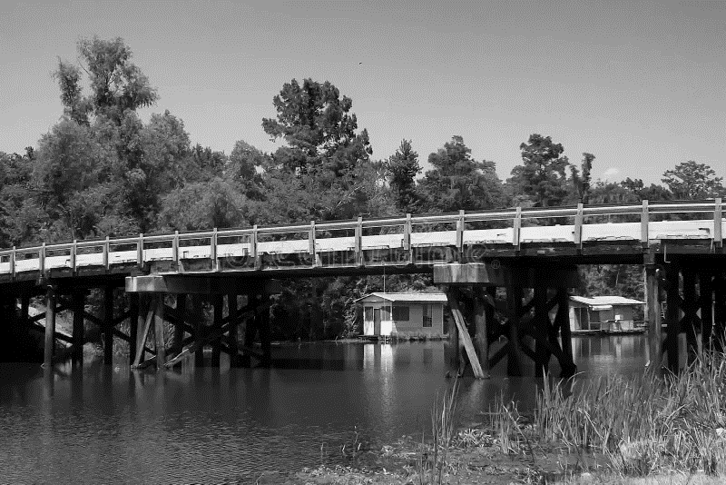


OFFICE OF LOUISIANA HIGHWAY CONSTRUCTION
American Council of Engineering Companies

Slide 16

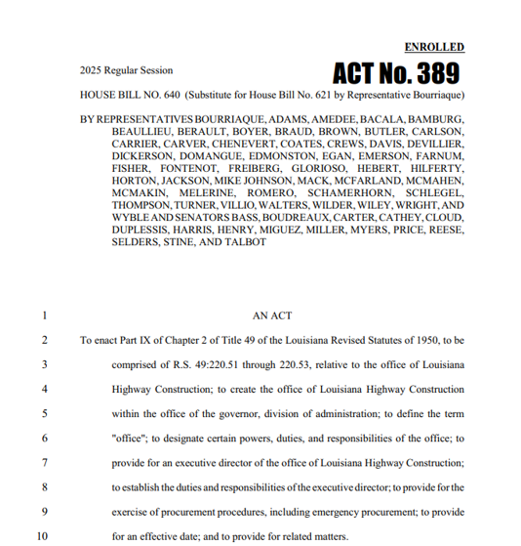

ABOUT US
Non-Federal Aid routes are made up of mostly rural roads.
Unlike major roadways, Non-Federal Aid routes are not eligible for matching funds from the federal government.

Slide 17
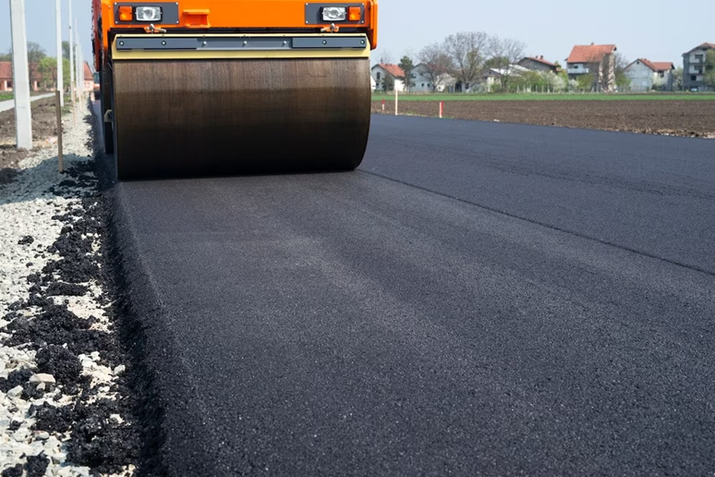
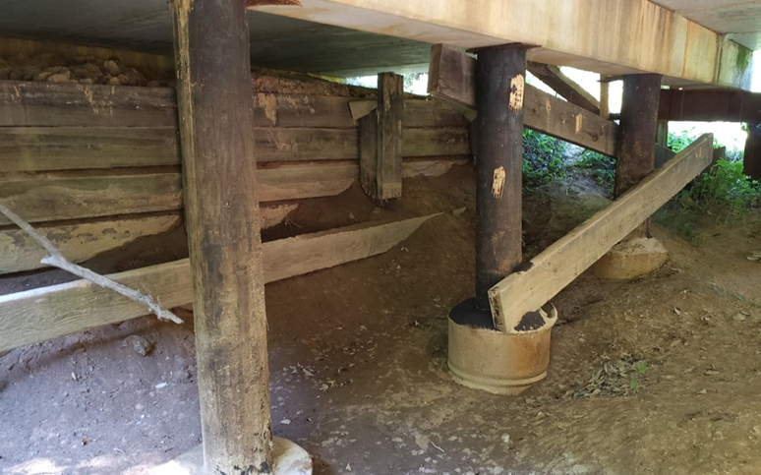
OPERATIONAL FOCUS AREAS
Non Federal Aid Routes
Bridge Bundle Packages

Slide 18
NON FEDERAL AID ROUTES
Organization Structure
4,080
OPERATIONS +
MAINTENANCE
CAPITAL PROJECTS
ROADWAYS
Miles of Roadway
Across the State
Program
Manager
2,800
CAPITAL PROJECTS
BRIDGES
BRIDGE INSPECTIONS
Bridges

Slide 19
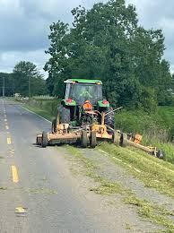
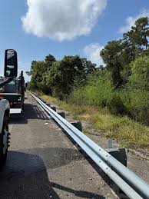
MAINTENANCE ACTIVITIES
Agreements with Parishes
Private Maintenance Contractors (IDIQ Format)

Slide 20
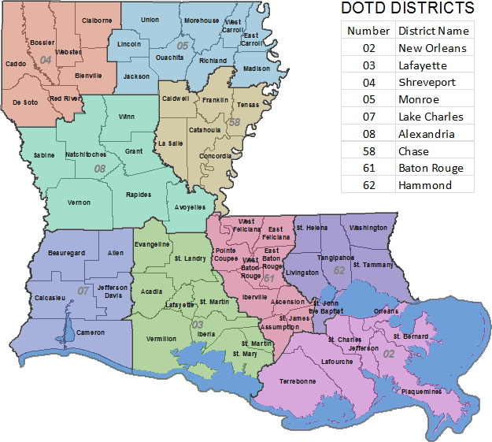
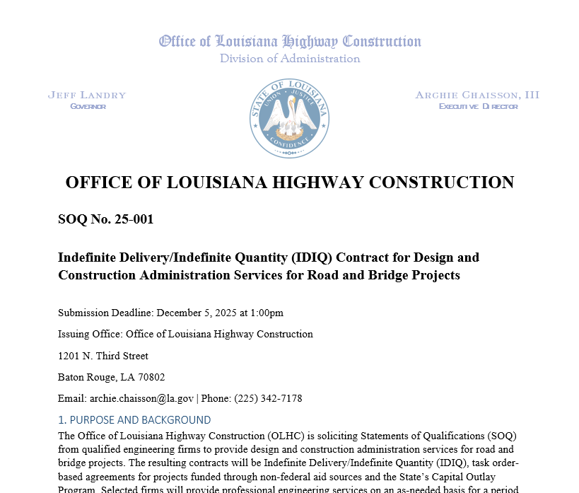
CAPITAL PROJECTS
Road and Bridge Design
Statewide Contracts (IDIQ Format)

Slide 21
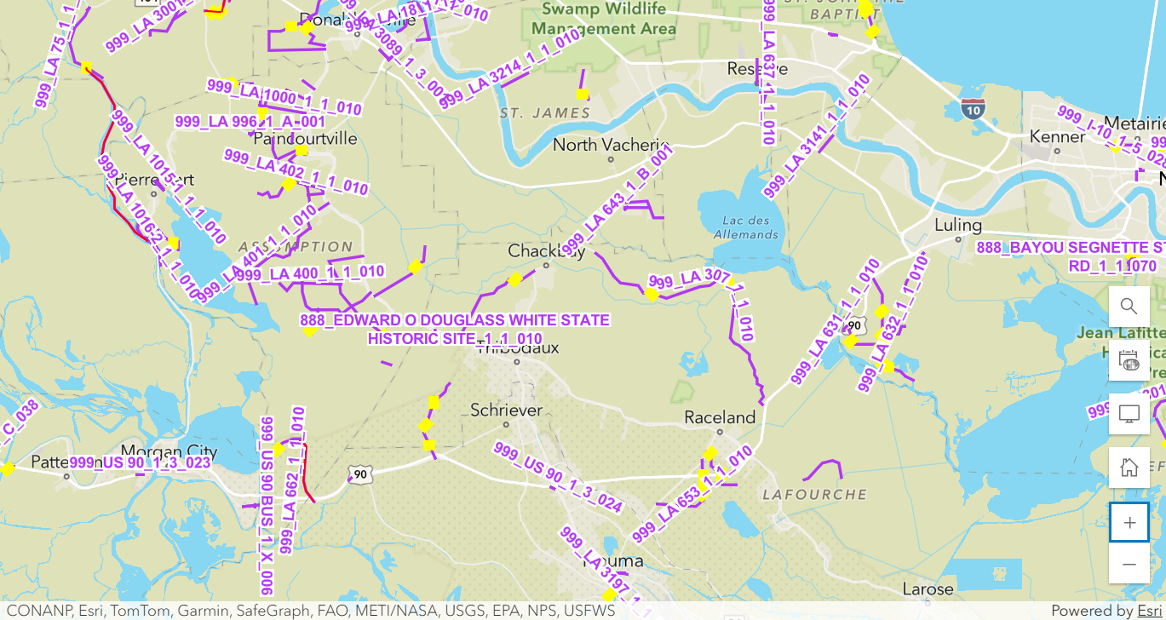

NFA ROUTES GIS SYSTEM

Slide 22
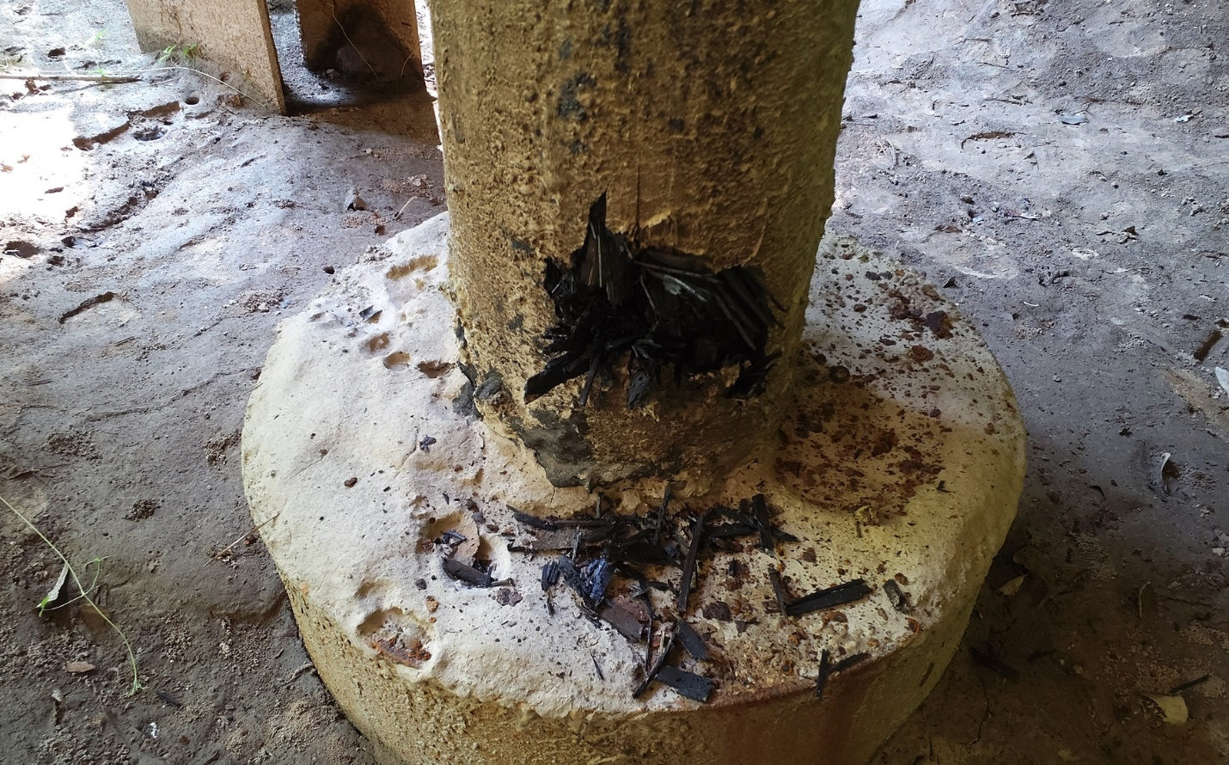
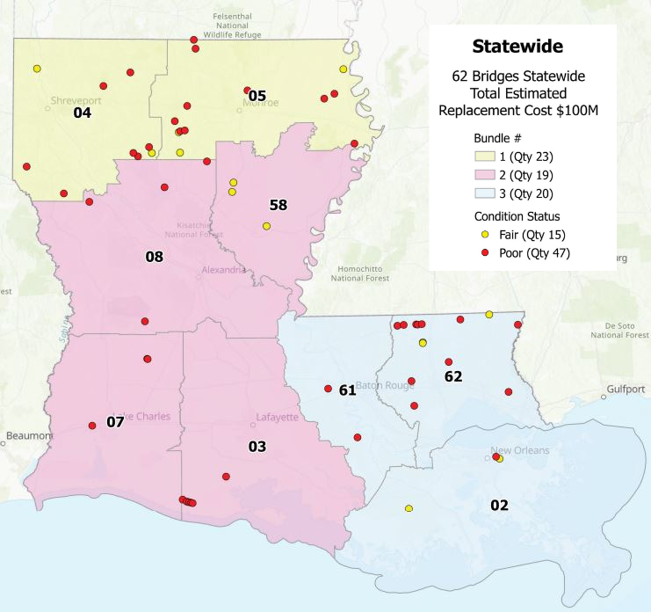

BRIDGE BUNDLE PROGRAM

Slide 23
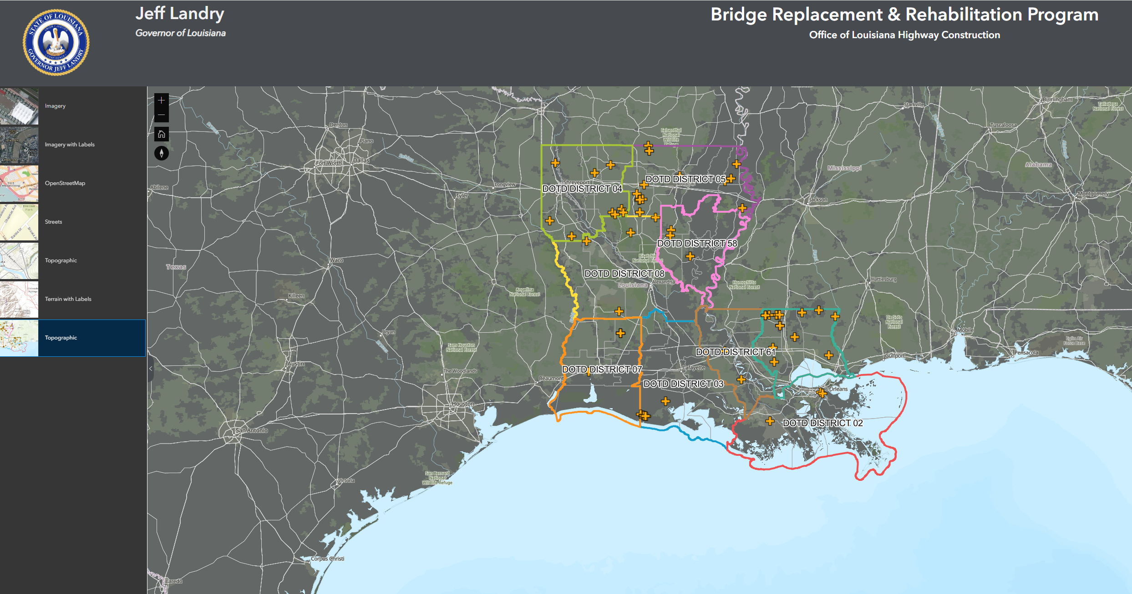

BRIDGE BUNDLE PROGRAM

Slide 24
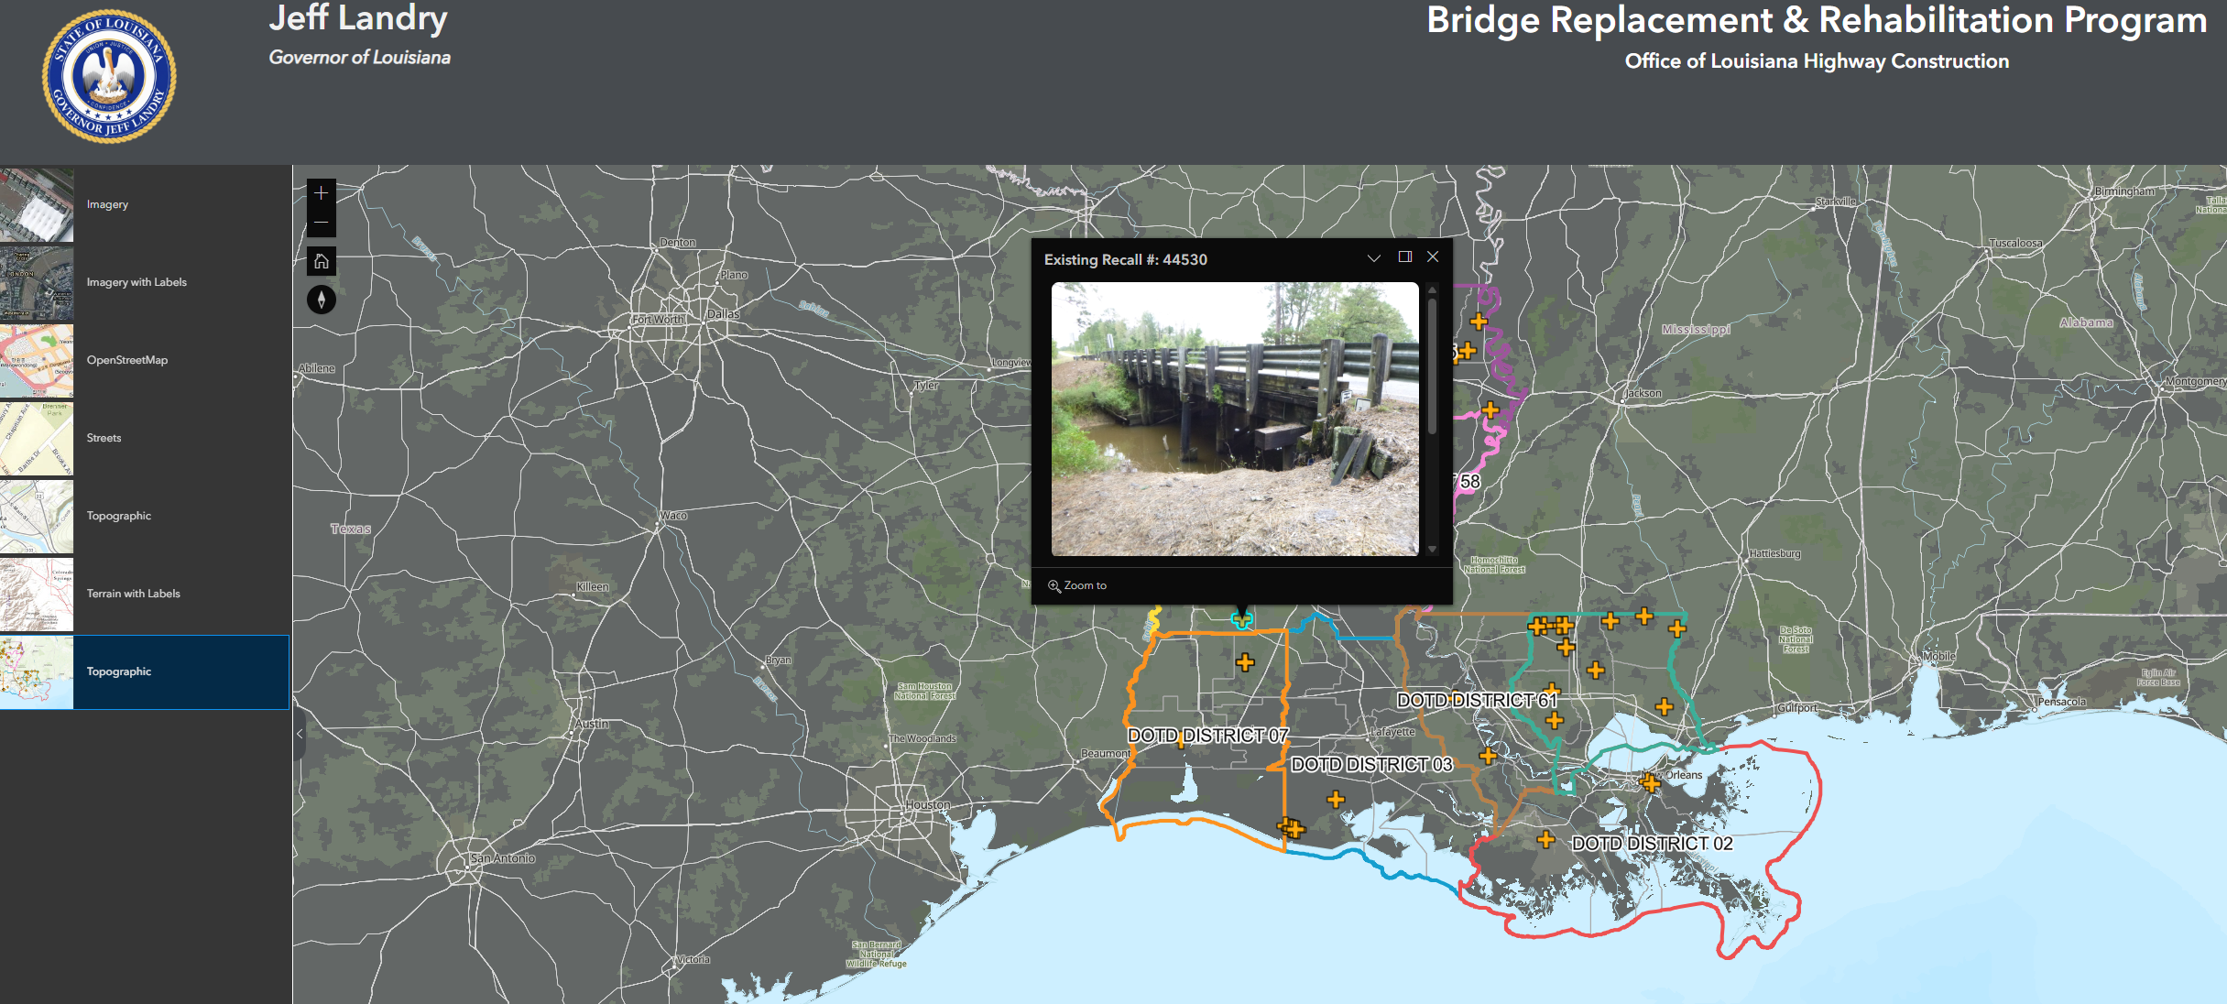
BRIDGE BUNDLE PROGRAM

Slide 25
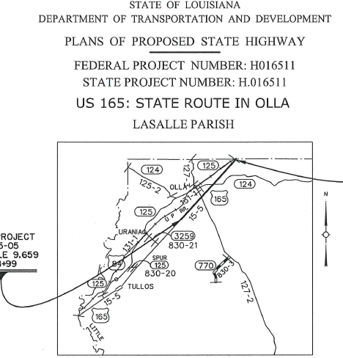
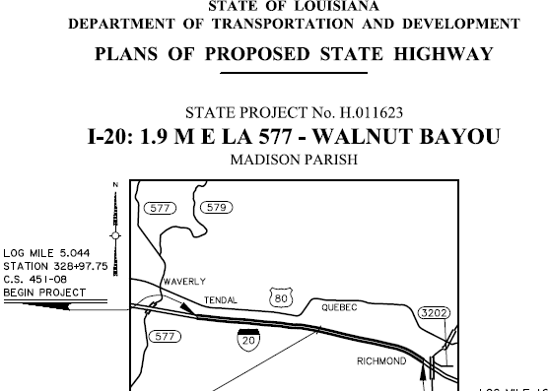
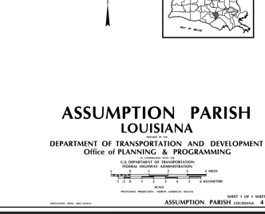
LTIF 2.0
$35 Million

Slide 26
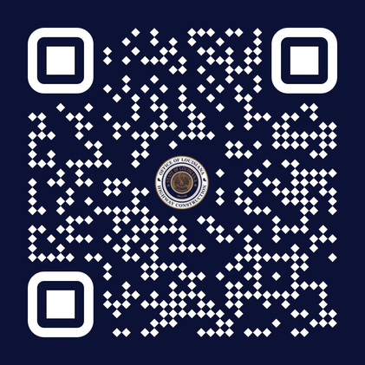
ARCHIE P CHAISSON, III
EXECUTIVE DIRECTOR
archie.chaisson@la.gov
(225) 342-7178

