Slide 1
ACEC Deep South Convention:
AI and Data Management in Engineering
Friday, July 25, 2025 | 9:30 – 10:30 AM
Moderator: Neil Jones, Cybersecurity Evangelist, Egnyte
Panel: Barker Dirmann, ACEC Louisiana
Kasey Anderson, ACEC Tennessee
Joelle Colosi, AEC Product Marketing Manager, Egnyte

Slide 2
What early indicators show a firm is ready—or not ready— to begin adopting AI?
Notes:
Panel Question:
Many firms fall into one of three buckets: early adopters, observers, or skeptics. What early indicators indicate a firm is ready—or not ready—to begin adopting AI?
Talking Points (Barker & Kasey):
Firms with strong internal communication and tech leads tend to pilot AI first.
Smaller firms may observe to avoid perceived risk, but that can stall progress.
Skeptics are often unclear on the business value or overwhelmed by technical terminology. Depending on the organization, there can even be a significant fear of AI adoption.

Slide 3
A/E Expertise Gap
74% of firms expect to be “mature” or “advanced” in digital transformation 3 years from now
41% Don't Use AI or Machine Learning
Deltek 46th Annual Clarity: Architecture & Engineering Industry Study 46th Annual Comprehensive Report
Notes:
Joelle:
Many firms lack strategic data management expertise; teams remain siloed.
Without clear ownership, old habits persist. Need aligned systems and process clarity.
Success depends on cross-functional collaboration and a data maturity roadmap. [Tech-savvy people, translators]

Slide 4
Labor Supply is in Flux
Firm demographics are changing.
~11% increase in the type of occupations at A/E Firm
Example Occupations at Firms in 2022 (but not 2012)
Financial and Investment Analysts
Software Developers
Software Quality Assurance Analysts and Testers
Data Scientists
Web and Digital Interface Designers
Industrial Engineering Technologists and Technicians
Food Science Technicians
Fine Artists, Including Painters, Sculptors, and Illustrators
Audio and Video Technicians
Healthcare Support Occupations
Notes:
Joelle:
New roles—data scientists, interface designers—demand modern infrastructure.
Outdated tools alienate new talent and reduce collaboration across disciplines.
Retention and productivity require platforms that support this evolving workforce.
This is why upskilling, process clarity, and intuitive technology adoption are becoming strategic imperatives.
If we want to attract and retain the next generation of talent, we need to equip them with systems that are as dynamic and collaborative as they are.

Slide 5
What AI Tools Are You Exploring?
Notes:
Audience Prompt:
By a show of hands: Who is actively piloting or implementing AI today?
Follow-Up Discussion:
What types of AI are you testing?
What problem are you trying to solve?
Audience Prompt:
Who would like to share their experiences?

Slide 6
What are realistic starting points for billable AI use?
Notes:
Panel Question to Joelle:
What are realistic starting points for billable AI use?
Talking Points:
Start with pain points that already eat into billable time: RFI tracking, insurance compliance checks, or file organization.
From the whitepaper: “Firms are increasingly turning to automation to eliminate repetitive, manual tasks that drain design and technical teams.”
Pilot tools embedded into platforms you already use, like AI-assisted file search or document classification.
Success should be measured by time saved, not just by tech adoption. Think of AI as a tool to restore billable focus.

Slide 7
How can AI help firms repurpose past project knowledge?
Notes:
Panel Question to Joelle/Neil:
How can AI help firms repurpose past project knowledge?
Talking Points:
Using searchable AI, firms can extract and repurpose past design specs, calculations, or submittals.
It reduces rework and accelerates project initiation, especially for repeat clients.
From the whitepaper: “An intelligent data environment should allow engineers to access and repurpose prior work without compromising integrity or control.”

Slide 8
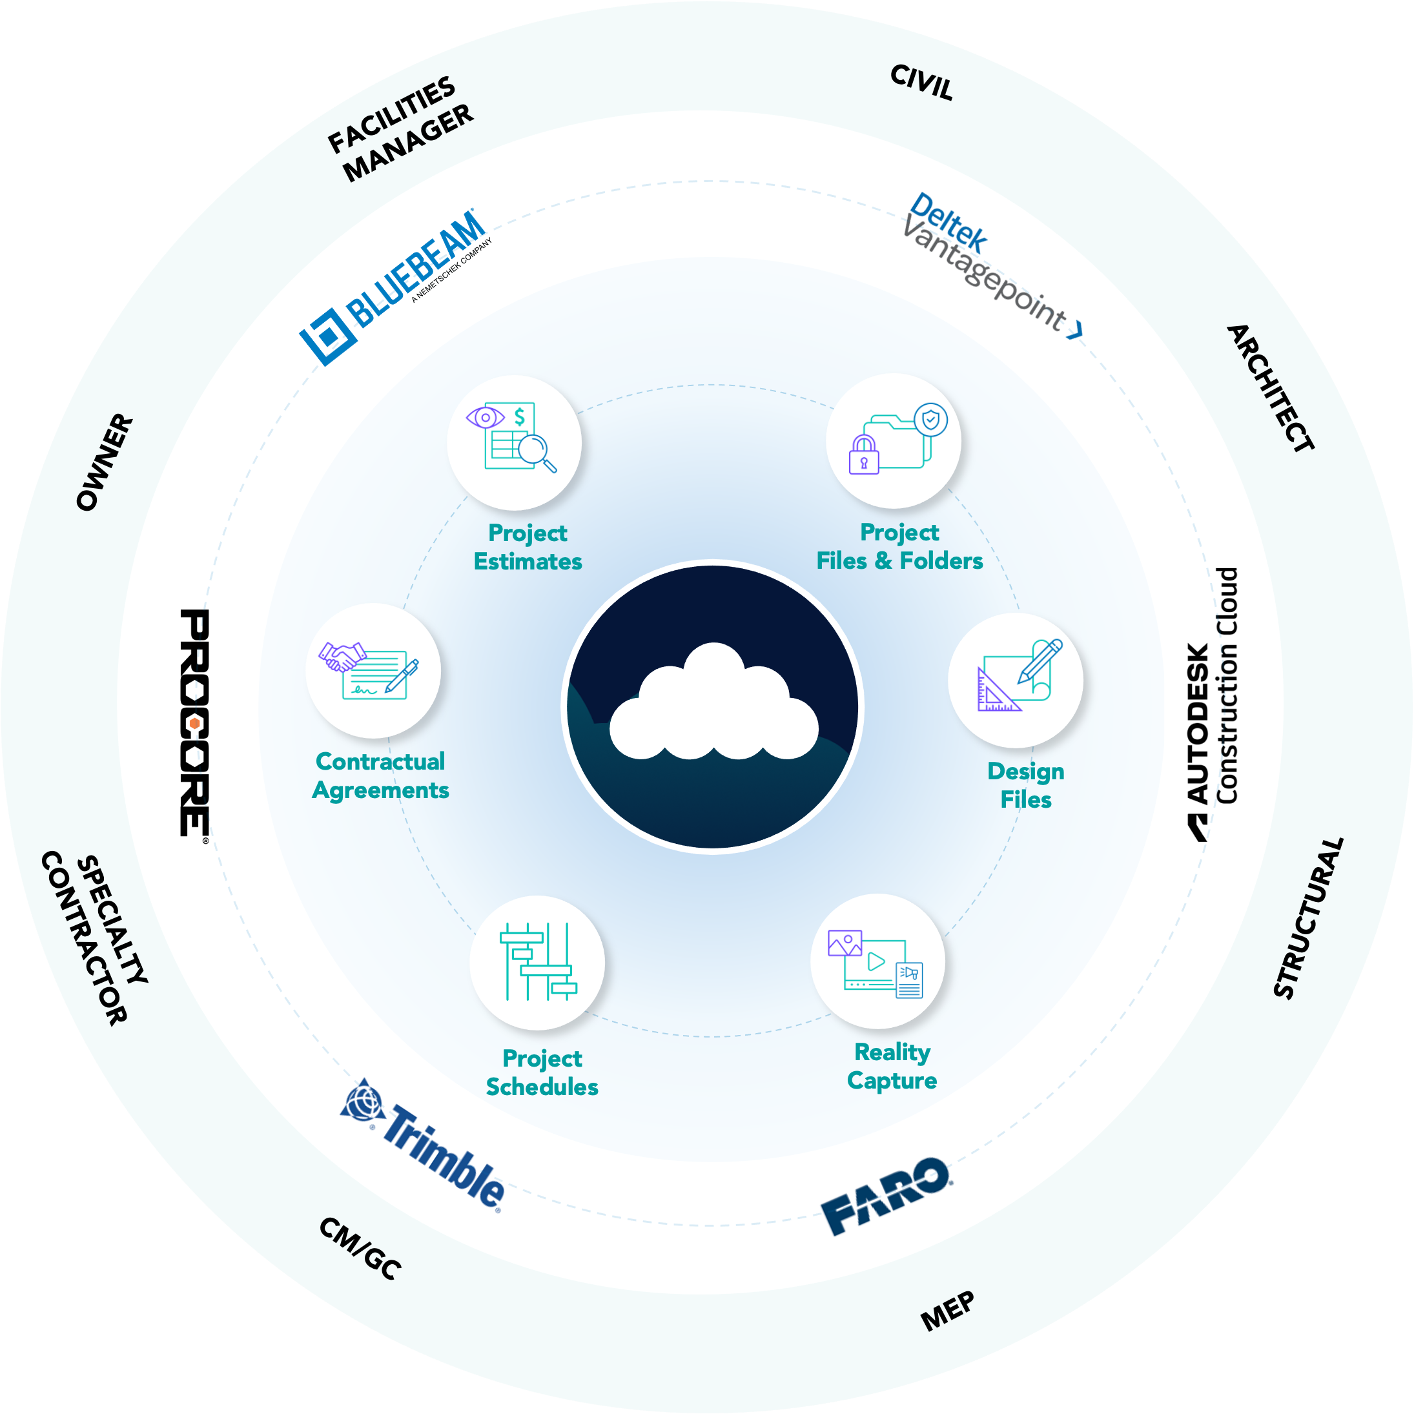







Create an Intelligent Data Environment.
From Chaos to Clarity
FRAGMENTED DATA
CENTRALIZED DATA
Multi-Cloud +
Document Sprawl
Fragmented
Collaboration
Limited Access
To Project Files
Version
Control
Compliance Challenges
Data Security Concerns
Notes:
Joelle:
Define the Intelligent Data Environment—centralized, governed, real-time, integrated.
This is a culture shift. When teams trust the data, everything becomes more efficient.

Slide 9
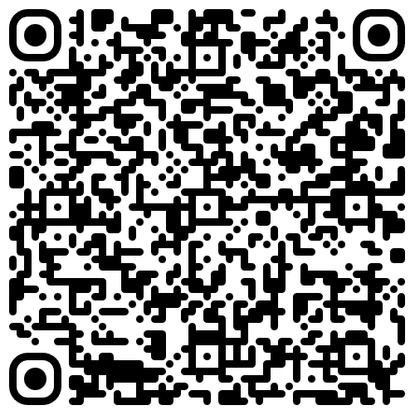
What’s the difference between enterprise AI and public AI tools?
Hundreds of LLM Servers Expose Corporate, Health & Other Online Data
Dark Reading, Nate Nelson 09/28/24
Notes:
Panel Question to Joelle/Neil:
What’s the difference between enterprise AI and public AI tools?
Talking Points:
Private AI respects permissions, versioning, and metadata rules within your organization.
Unlike public tools, enterprise AI can be audited, governed, and restricted to firm-owned data.
Prevents hallucinated outputs by narrowing data to verified sources—this ensures trust.
(Extremely important): It prevents your sensitive data from being picked up by Large Language Models, which can risk your data.
Although this article is technical in nature and won’t be explicitly referred to in the session, it details the potential risk to any organization.
Audience Prompt:
What privacy concerns do your teams have with AI?

Slide 10
Are clients expecting AI to lower costs or speed up delivery?
Notes:
Panel Question to Barker and Kasey:
Are firms being asked to deliver faster or more cheaply due to perceived AI productivity?
Talking Points:
Clients often assume AI will reduce cost or eliminate mistakes, even when firms haven’t implemented it.
This creates pressure to “perform AI” before building actual capacity.
There’s a growing gap between clients’ expectations and internal capabilities.
Internal and external education is key to aligning timelines and outcomes.
Audience Prompt:
Are your clients expecting AI to reduce cost or accelerate timelines?

Slide 11
What’s one AI myth you'd like to debunk?
Notes:
Panel Question to All:
What’s one myth or misconception about AI you’d like to debunk?
Talking Points:
Myth (Joelle): 'AI is too complex or expensive for smaller firms.'
Truth: AI is becoming integrated into tools you already use, often without requiring significant investment.
From the whitepaper: “Digital maturity isn’t about size—it’s about mindset and strategy.”
Myth (Barker/Kasey): 'AI is replacing engineers.'
Truth: AI enhances—not replaces—human decision-making.
Myth (for Neil): ‘AI is a brand-new, shiny thing that never existed before.’
Truth: The concept of AI dates back to the 1950’s. Only recently have companies been able to perform AI at scale. Machine learning- a form of AI- has been incorporated into cybersecurity solutions for more than a decade.
Audience Prompt:
Which of these is the biggest barrier to AI adoption at your firm?
Budgetary Support
Data Security Concerns
Internal Resistance
User Education

Slide 12
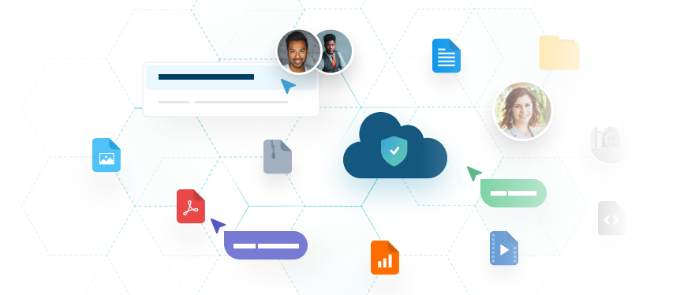


Future-Proof Your Strategy
5 Easy Steps
Audit your current environment
Centralize and govern your files
Align access controls with team roles
Automate workflows through integrations
Pilot AI and monitor outcomes
Notes:
Joelle:
Audit your environment
Centralize & govern files
Align access controls
Automate via integrations
Pilot AI and monitor
When it comes to AI, start small.
There are member firms that are looking to pilot AI.
This isn’t a one-size-fits-all journey. It’s a strategy that scales.

Slide 13
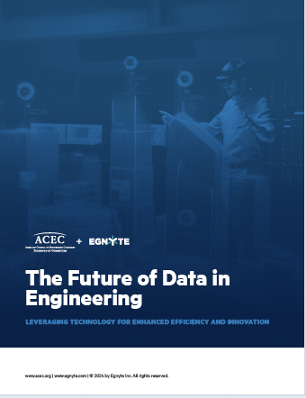

The Future of Data in Engineering
Notes:
Joelle:
Co-authored with Thomas Grogan, Sr. Director, Technology Committee, ACEC
Share that the full whitepaper is available—deeper insights, practical next steps.
It’s a useful framework for firms at any stage of their digital transformation.

Slide 14
Thank You!
Any Questions?

