Slide 1


WELCOME!

Slide 2

ACEC of LOUISIANA Welcomes You!
Barker Dirmann President & CEO

Slide 3

ACEC National Update
Sean McCone, P.E., CCM
2024 – 2026 Vice Chair
Johnson, Mirmiran & Thompson, Inc.

Slide 4

Session I Sponsored By
John Krebsbach, National Director of Business Development

Slide 5



LEADERSHIP DEVELOPMENT
Adapting to Change:
Dinosaurs or Dolphins?
Gary Golden, Golden Opportunities

Slide 6

Session II Sponsored By
Lydia R. Zabrycki, Vice President | CAPTRUST

Slide 7

Project Management
How to streamline Project Management & Boost Productivity with ai
Brett Tushaus, Vice President of Product Management
Deltek

Slide 8
LUNCH BREAKOUT
COMMITTEE SESSIONS
*ACECL Transportation Committee (Jefferson Ballroom)
*ACECL Legislative Committee (Orleans Room)
*ACECL Facilities Committee ( St. Tammany Room)

Slide 9
Transportation Committee

Slide 10

Session III Sponsored By

Slide 11

Risk Management
Risk Management and ai
Lee Ann Wheeler
Client Executive, Greyling Insurance

Slide 12

Artificial Intelligence in Design & Construction
ACEC Louisiana

Slide 13


Outline
Are we in new territory?
Risks & Opportunities faced by our clients
Developing an AI Policy
How can we advise our clients?

Slide 14
Are we in new territory?

Slide 15


Slide 16
Chat GPT
Machine Learning
Digital Twins
Technology Products
Optimization
Augmented Reality
Building Information Modeling (BIM)
Artificial Intelligence
Generative AI
Digital Transformation
Data Science
Generative Design
Technology Products
Graphic Information Systems (GIS)
Automation
Parametric Design
Virtual Reality
3D Printing
Acceptable Use Policy (AUP)

Slide 17
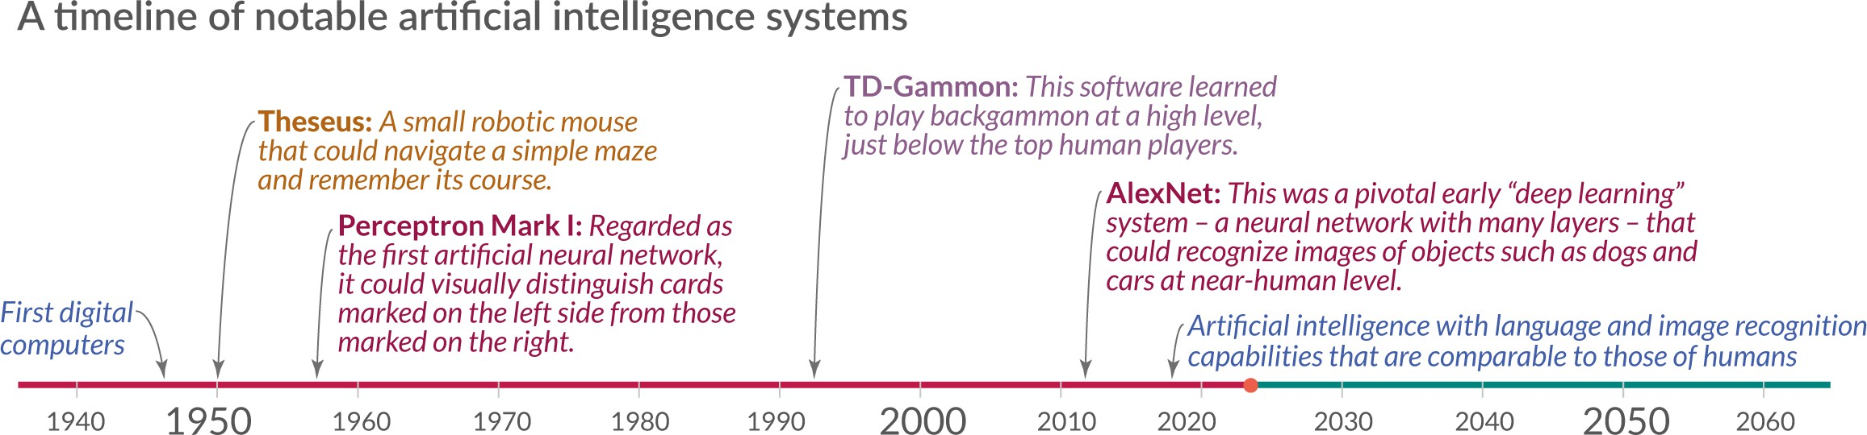
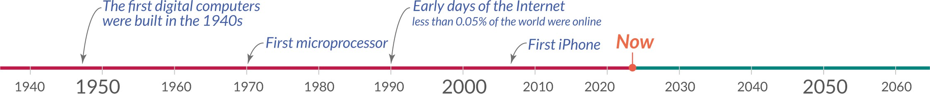
AI, a Brief History
AutoCAD
Revit
Building Information Modeling (BIM)
Notes:
Engineers began the automation journey in the 1960’s with the advent of structural analysis software.
The optimization kick was in full swing in the 1980’s.
Engineers began making design decisions using computer programs in the 1980’s.

Slide 18
Evaluating AI Implementation in Firms
45%
40%
35%
30%
25%
20%
15%
10%
5%
0%
Innovator
Early Early Majority Late Majority Laggard Adopter
Survey Response
Statistical Average
Notes:
Innovator (2.5%) – The first to adopt a new idea or project; willing to take risks; seen as adventurous.
Early Adopter (13.5%) – Next up after Innovators; seen as respected leaders within industry; carefully adopts new ideas early.
Early Majority (34%) – Adopts new ideas just before the average person; Deliberate and thoughtful in adoption process.
Late Majority (34%) – Adopts an innovation only after the majority of society has accepted it; skeptical and cautious.
Laggard (16%) – Last to the party; Bound by tradition and skeptical of change.

Slide 19

Integration of AI by the Numbers
75% of firms are using AI in some capacity throughout their business.
28% of firms are using AI in their design work in some capacity.
25% of firms said their legal depts are
using AI in contract reviews.
15% use AI to fill gaps in staffing needs.

Slide 20


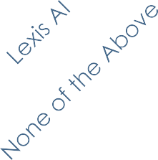
Which AI Platform Is Your Firm Using?
70%
Most Firms Are Using:
  Microsoft Copilot: 53%
  ChatGPT: 32%
  2 or More Platforms: 32%
    22% are using both Microsoft Copilot
and ChatGPT
60%
50%
40%
30%
20%
10%
0%
Firms not utilizing a surveyed AI platform are split 50/50 between “Early Majority” and “Late Majority” adopters.

Slide 21
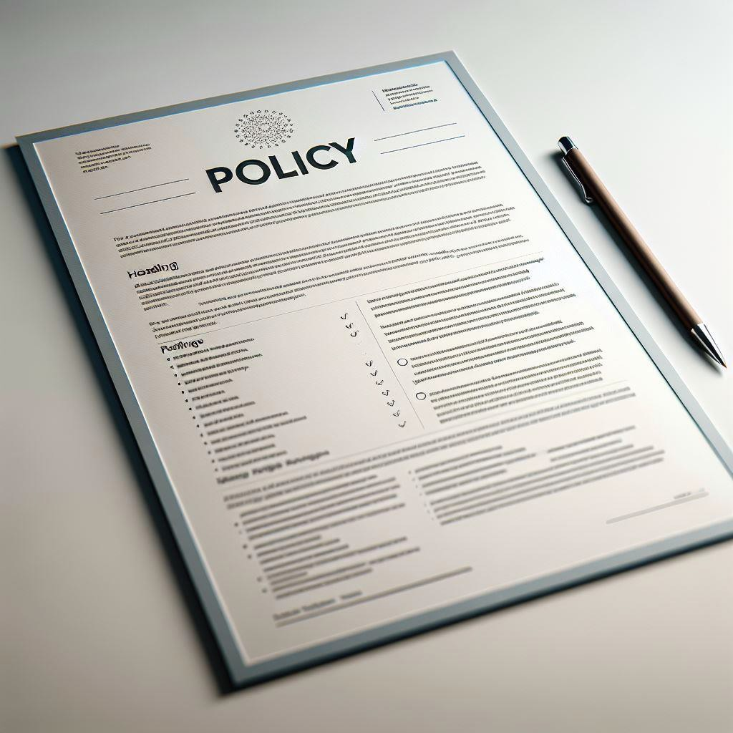


Formal guidelines around AI
RESPONSES
Yes No
14%
86%

Slide 22

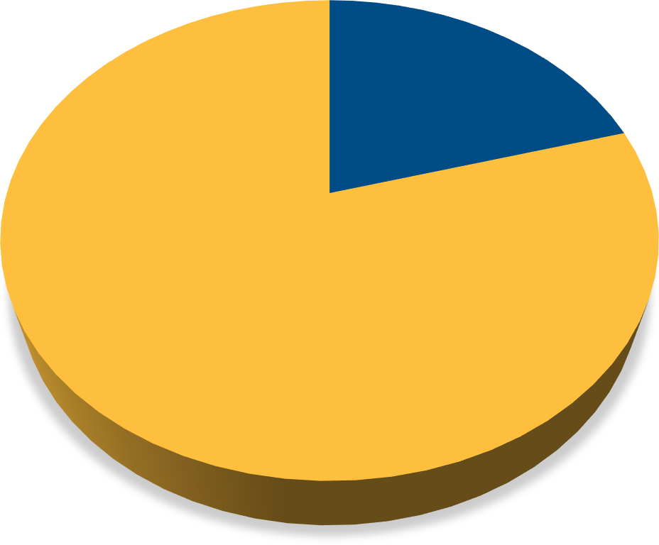
Awareness of AI Usage by Project Participants
Responses
21%
79%
Yes No

Slide 23




Internal Evaluation and Discussions on AI’s Impact on the Standard of Care
Responses
No Answer 24%
Yes
27%
No 49%

Slide 24
Opportunities & Risks

Slide 25
Opportunities
Design and Simulation
Project Management
Workforce Challenges
Predictive Maintenance
Generative Design
Operational Efficiency
Automation of Repetitive Tasks
Talent Acquisition and Management
Decision Support Systems
Enhanced Safety on Project sites
Process Automation
Employee Engagement

Slide 26
Risks
Ownership of data & models
Data Protection
Cybersecurity
Licensing
Archiving & Retrieval
Legal Advice Varies widely
Tech Companies muscle in on the AEC Industry
IP Infringement
Media Liability
Bias and fairness
Hallucinations
Misinformation
Notes:
Projects teams are increasing relying on shared computer models and on data sets increasingly hosted on cloud services. Who on the team owns the data and is responsible for its curation and preservation?
The project data is accessed by numerous parties. Who is responsible for protecting the data? Who is liable if the data is corrupted?
When cloud services are attached, who is liable for damages?
If one party owns the data and/or software, are there clear licensing agreements in place all parties needing to access the data and software?
Projects have long lives. Claims linger after projects are completed and occupied. Who is archiving the data and recuring future retrieval?
The Professional Engineer is in “direct supervisory control of the AI/ML algorithms
This is the requirement in the engineering statutes.
Is the professional engineer sufficiently knowledgeable of the underlying algorithms?
Does the professional engineer have sufficient fee to do the job of being “in responsible charge?”
Legal Advice Varies Widely
How do you determine liability when the culprit doesn’t have an ID, a social security number, or even a pulse?
Tech Companies want to muscle in on the AEC Industry

Slide 27
Standard
of Care
Schedule
RISK
Fees
Professional
Oversight
Notes:
Marketing efforts by design firms are volunteering a higher standard of care.
Clients are listening to the media and expecting a higher standard of care.
Heightened standard of care
Compressed Schedules & Lower Design Fees
Firms sign up to overly aggressive schedules.
Reliance on Technology without sufficient professional oversight.

Slide 28


Who has liability?
An offshore platform requires inspection to determine whether any of the welds in the supporting structure are showing signs of fatigue and need to be repaired.
The owner engages an engineering firm to perform the inspections & perform the evaluation.
The engineer deploys drones to perform the inspection by photographing and videoing the welds. The images are uploaded in the cloud and an AI/ML algorithm is deployed to assess the welds and determine which welds require repair.
A PE working for the engineering firm, reviews the recommendations from the AI/ML system and issues the recommendations to the owner of the platform.
The recommendations of the engineering firm are accepted by the owner who hires a contractor to execute the repairs.
One month after the completion of the weld repairs, a weld that was not repaired fails and the platform is out of commission. The cause of failure is identified to be fatigue.
Who has liability?

Slide 29


AI is a…
TOOL
NOT A SOLUTION

Slide 30


Developing an AI Policy
GREYLING INSURANCE BROKERAGE & RISK CONSULTING
Create an image to serve as a divider page in a powerpoint presentation introducing a section ₉₃
on tips and practical uses of generative AI to a group of in-house counsel

Slide 31
Purpose & Policy
Scope
Advance Approval / Use of Specific GAI Tools
Acceptable Uses
Compliance with Laws, Standard of Care, and Contracts
Human Review & Responsibility
Transparency
Data Privacy
3rd Party IP Protection
Ownership of Results
Monitoring
Compliance with Other Firm Policies
Training
Reporting
Enforcement of Policy / Disciplinary Terms
Policy Reviews
Employee
Acknowledgment
Common Generative AI “Acceptable Use Policy” (or AUP)
Provisions

Slide 32

Compliance with Laws, Standard of Care, and Contracts
GREYLING INSURANCE BROKERAGE & RISK CONSULTING
Use of GAI tools must comply with all applicable laws and regulations. Any activity that violates the law, such as harassment, cyberbullying, or illegally sharing copyrighted material, is strictly prohibited.
GAI may not be used to deliver opinions in a scope of practice in which the user lacks the necessary expertise or in which they are unable to verify the accuracy or trustworthiness of the data.
The Company’s client agreements/contracts take precedence over the permissions granted by this policy regarding the use of GAI tools. Thus, if a client agreement imposes restrictions on the use of GAI tools, those restrictions must be followed.

Slide 33


Human Review & Responsibility
GAI does not change the responsibility of employees for the quality, accuracy, and completeness of their work. GAI-generated content must be fact-checked to ensure that all information is accurate and up-to-date. This includes verifying sources, checking data, and ensuring that any claims made in the content are supported by evidence. GAI-generated content should be viewed as a resource to assist humans in completing a finished product, not the finished product.
Human oversight will be maintained throughout the GAI process and final decisions will involve human and engineering judgment, ensuring accountability for the outcomes produced by GAI tools. All work product produced shall follow company quality control requirements; under no circumstance shall any GAI tools be used to replace any part of the quality control requirements.
Individuals using GAI tools are responsible for their actions and decisions.
Blaming a GAI tool for an
incorrect or inappropriate decision is unacceptable.

Slide 34



Transparency
All GAI-generated content must be clearly labeled as such. The use of GAI in generating content should be transparent to employees, peers, stakeholders, and clients. This ensures we maintain our high professional standards and authenticity.
The Company will engage clients in open and transparent discussions about the use of GAI tools in professional services, providing clear information about the capabilities, limitations, and potential impact of GAI tools. Client communication will emphasize the Company’s commitment to ethical and responsible GAI use, seeking to build trust and foster collaborative partnerships with clients.
GREYLING INSURANCE BROKERAGE & RISK CONSULTING

Slide 35

Data Privacy
All Company policies and regulations regarding data privacy and security must be strictly adhered to. Employees should view inputs to a GAI tool as akin to disclosures to a third party. Just as you would not email certain confidential, proprietary, or protected information to an outside party, you should not input such information into a GAI tool; this includes, but is not limited to:
Company financial or strategy information
Business plans and models
Information related to a company’s business operations
Franchise evaluation material
Client lists and other trade secrets
Intellectual property and/or other similar information
Personally identifiable information
If you are not sure if information may be used with a GAI tool, please ask first.

Slide 36

3rd Party IP Protection
The Company is committed to respecting the intellectual property rights of others. Employees must be mindful that outputs from GAI tools may include the intellectual property of others, which the Company is not permitted to use without appropriate attribution or other requisite action. As GAI tools may produce content that is plagiarized from its knowledge base, including copyrighted works, no text generated or partially generated from a GAI tool shall be used for final work products, nor shall it have a company copyright or trademark.

Slide 37
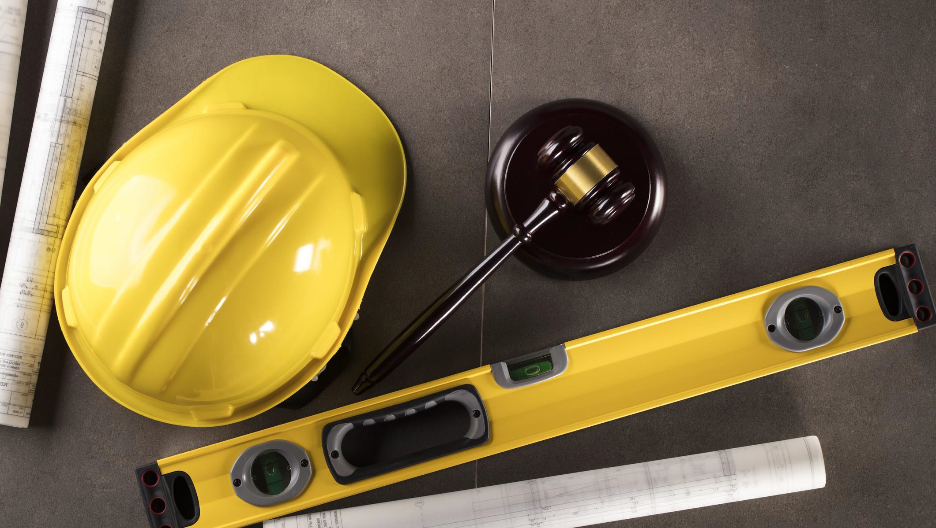
Ownership of Results
The Company retains ownership of all resulting products, data sources, and model parameters.
Employees may not
reproduce, distribute, or modify items without prior authorization.

Slide 38

Monitoring
The Company reserves the right to monitor, audit, and review the use of GAI tools by its users, and to suspend, restrict, or terminate the access or use of GAI tools by any user, at any time, without prior notice or consent, if the Company determines that the user has violated this policy or misused GAI tools.
Employees should not have any expectation of privacy with respect to any inputs to or outputs from GAI tools used on Company information systems.

Slide 39
This policy is intended to add to - not contradict, limit, or replace
GREYLING INSURANCE BROKERAGE & RISK CONSULTING
other applicable mandatory rules, policies, legal requirements, legal prohibitions, and contractual obligations, all of which remain in full force and effect. Any use of GAI tools under this policy must also comply with the other relevant policies, internal controls, and guidelines of the Company, including our:
  Anti-Harassment/Anti-Discrimination Policy
  Proprietary Information Policy
  Privacy Policy
  Computer End-User Policy
GAI tools must not be used to create content that is inappropriate, discriminatory or otherwise harmful to others or the company.
Employees must apply the same security best practices we use for all Company and customer data. This includes using strong passwords, keeping software up-to-date, and following the Company’s data retention and disposal policies.
Compliance with other firm policies

Slide 40

If you become aware of an actual or potential violation of this policy, or have reason to believe that any of the following has been downloaded to or installed on Company’s networks, systems, or devices, you must promptly disclose this fact to the Company’s together with all relevant documents and information:
An unlicensed GAI Tool, if usage requires a
license.
A GAI Tool that has not been approved for use according to this Policy.
A GAI Tool that is used outside of the approved manner or scope.
A GAI Tool that poses an identified, unaddressed security risk or contains any material defects or malicious code.
A GAI Tool that reports inaccurate information or regularly makes up information.
Reporting

Slide 41


Enforcement of Policy / Disciplinary Terms
Any user who violates this policy or misuses GAI tools may face disciplinary action, up to and including termination of employment or contract, depending on the severity and frequency of the violation, and at the Company’s sole discretion. The Company may also take legal action against the user, if the violation causes or results in any damage, loss, or liability to the Company, its clients, partners, or the public.

Slide 42
Recording Virtual Meetings
Minimum of 3 files created (typically will be MP4 video, MP4 audio, .txt of any chats); enabling audio transcript option creates a 4th file (.vtt text file)
“Would I have brought a video camera to this meeting if we were all together in person around a conference table?”
Tips:
Recording should be the rarely-used exception, not the rule.
Limit virtual meeting recording permissions.
Address recordings specifically in
document retention policies.
Do not just keep the audio transcript – AI transcription tools are prone to errors, and without the actual recording you have no way to evaluate the accuracy later.
Depending on the account settings, every individual participant may be able to locally store recorded copies of the meetings

Slide 43
How can we advise our clients?

Slide 44
Do not over promise and establish a heightened standard of care.
There is considerable hype in the media about the transformative power of Artificial Intelligence. Be cautious in making promises to the client on what can be delivered.
Be careful not to promise perfection, reduced errors, faster delivery, etc…. Yes, some such statement may be helpful to win the project; but be cautions on what gets into the proposal and the contract.
Be clear on what is possible to deliver today, what has been properly QA’d and what can be relied upon to deliver today. Be clear on what the tools will cost and who will be paying for the licensing fees.

Slide 45
Be diligent to secure enough fee and time t execute the engineer’s statutory responsibilities as the “engineer of record”
AI / ML tools may be deployed on the project, but a Professional Engineer still needs to take responsibility for the work product.
AI / ML tools may actually create more work than more traditional design methods. Yes, AI can create 1000 options of interior floor plans. Who has the time to go through this number of options, explain them to the client and lead a decision-making effort?

Slide 46
Be clear when services are no longer professional design services
T&C’s appropriate for design services may not be appropriate for digital services or for the sale of software.
Use the appropriate contracting methods and the appropriate terms & conditions.
Where digital services are being offered, is there an appropriate “Service Level Agreement” in place? Do you have the resources in place to deliver to the “Service Level Agreement”?

Slide 47
Al & ML are multidisciplinary endeavors that require appropriate data. Do you have the right skills and data in place?
Do you have the right staff and/or consultants in place to deliver the service?
Do you have good quality data that is appropriately curated? Without good data most of the AI / ML algorithms deliver poor results.

Slide 48
Address the issue of licensing and ownership of data and computer models
Address licensing, ownership, maintenance issues around data and computer models explicitly in your contracts. Do not assume that something will be figured out during the project.
Develop an “Acceptable Use Policy, AUP” for all users of software and technology products.

Slide 49
Perform due diligence on your vendors & subconsultants
Vendor and Consultant Questionnaires.
Simply ask…”Are you using AI to deliver services to us?” If the answer is yes, include indemnity and insurance requirements.
Intellectual Property Indemnification. Supplier shall indemnify, defend and hold Buyer and Buyer’s customers harmless from any and all claims against Buyer and/or Buyer’s customers alleging intellectual property infringement of any patent, copyright, trademark, trade secret or other intellectual property rights of any third party arising out of the use, sale, importation, distribution, reproduction or licensing of any product, service, article or apparatus, or any part thereof constituting goods or services furnished under this Order, as well as any device or process necessarily resulting from the use thereof (the “Indemnified IP”), including the use, sale, importation, distribution, reproduction or licensing of such Indemnified IP, in foreseeable combinations with products or services not supplied by Supplier. Buyer shall notify Supplier promptly of any such suit, claim or proceeding and give Supplier authority and information and assistance (at Supplier’s expense) for the defense of same, and Supplier shall pay all damages, costs and expenses incurred or awarded therein, including reasonable attorneys’ fees. Notwithstanding the foregoing, any settlement of such suit, claim or proceeding shall be subject to Buyer’s consent, such consent not to be unreasonably withheld. If use of any Indemnified IP is enjoined, Supplier shall, at Buyer’s option and Supplier’s expense, either: (a) procure for Buyer the right to continue using such Indemnified IP; (b) replace the same with a non-infringing equivalent; or (c) remove the Indemnified IP and/or halt such use of the Indemnified IP in providing goods and/or services under this Order and refund the purchase price to Buyer, and in all cases, Supplier shall be responsible for all related costs and expenses. Supplier agrees that it shall use commercially reasonable efforts to obtain an intellectual property infringement indemnity from its direct or indirect suppliers providing goods and/or services as part of the deliverables under this Order consistent with the intellectual property infringement indemnity it provides to Buyer in this Order.

Slide 50
3 Distinct Offerings by Design Professionals;
Distinct Terms & Conditions; Distinct Risk profiles
Professional Services
with or without
Technology Based Services
Technology Based Services
Technology Products / Software
Notes:
When do professional services morph into selling software products?
How deliberate are design firms into keeping clear separation between professional services and the sale of a product?
How diligent are we in securing coverage for Technology Based Services & Technology Products in PL policies?
Tech E&O policies provide coverage for companies selling technology products or offering consulting services related to information technology.
Coverage is intended to cover:
Acts, errors or omissions in the performance of technology services
Defects, Deficiencies or inadequacies in a technology product
Failures in performance of tech products or services in accordance with a contract
Tech E&O policies are not a substitute for a Professional Liability policy. For AEC firms, Tech E&O policies complement a PL policy.

Slide 51
Other exposures in an AI world / Is there coverage?
Exposure
Insurance Coverage
IP Infringement
  Whose IP was used to train the AI system utilized? It will be very rare for firms to own proprietary AI systems.
Corporate decision making influenced by AI products.
  IP claims
  breach of fiduciary duties
  Shareholder derivative claims
Employment Practices impacted by AI driven decision making
  Hiring decisions
  Promotion decisions
  Performance evaluations
  Wrongful termination claims
  Discrimination claims
  Harassement claims
Media exposures impacted by AI driven marketing & communications
  Content creation
  Defamation
  Invasion of privacy
  IP infringement
Intellectual Property Insurance
  Many PL policies contain exclusions for claims arising from IP infringement
D&O Insurance
  Consider whether limits are adequate.
Employment Practices Liability Insurance (EPLI)
  EPLI can help protect businesses from potential algorithmic bias-related lawsuits.
Media Liability Insurance
  For businesses that use AI to generate and curate content, coverage can protect again claims of defamation, invasion of privacy and IP infringement

Slide 52
Thank You !

Slide 53
Roundtable Discussion
It’s Our Business

Slide 54
Please Join Us for Our Cocktail Reception!

