Slide 1
ACEC Deep South Convention Presents:
AI Customer Success Stories & Best Practices
Saturday, July 26, 2025 | 11:00 AM – 12:00 PM
Speakers: Neil Jones, Cybersecurity Evangelist, Egnyte
Joelle Colosi, AEC Product Marketing Manager, Egnyte
Notes:
Welcome everyone! I’m Joelle Colosi, our AEC Product Marketing Manager and I’m joined by Neil Jones, Cybersecurity Evangelist at Egnyte, and
Today we’re digging into real stories of how firms are using AI—not just to check a box, but to truly improve how they work.
Our goal is to make AI real for engineering firms.
No jargon, no hype—just practical examples, clear steps, and a few great stories.
We’ll also be hearing from you throughout the session.

Slide 2
Key Statistics: AI’s Adoption
HiddenLayer “AI Threat Landscape Report”¹:
  98% of IT leaders consider their AI models as crucial for business success.
Cloud Security Alliance /Google Cloud “State of AI & Security Survey Report”²:
  2024: 55% of organizations planned to adopt GenAI solutions.
  2024: 48% of professionals were confident about their organization’s ability to execute a strategy for leveraging AI in security.
Notes:
Resource- Footnote #1: https://hiddenlayer.com/threatreport2024/ Resource- Footnote #2: https://cloudsecurityalliance.org/artifacts/the-state-of-ai-and-security-survey-report#

Slide 3
Key Statistics: AI’s Impact
ISC(2) “AI in Cyber 2024” Report³:
75% of respondents are moderately to extremely concerned that AI will be used for cyberattacks or other malicious activities.
Cisco 2024 Data Privacy Benchmark Study⁴:
27% said their organizations have banned the use of GenAI applications.
Notes:
Resource- Footnote #3: https://www.isc2.org/Insights/2024/02/AI-Survey Resource- Footnote #4: https://investor.cisco.com/news/news-details/2024/More-than-1-in-4-Organizations-Banned-Use-of-GenAI-Over-Privacy-and-Data-Security-Risks---New-Cisco-Study/default.aspx

Slide 4
How many of you are actively using some form of AI in your Firm?
Notes:
Audience Prompt: (Joelle)
I’m hoping you will help us…
Some of you may have attended our session yesterday, but let’s kick it off with
Let’s kick things off with a quick show of hands—how many of you are using some form of AI today?
Follow-up: (Joelle)
Any tools beyond ChatGPT? And what are you hoping AI could help you solve in your daily work? (multiple choice, automating repetitive writing, deep analysis,

Slide 5
A Closer Look: The Maturity Gap in Engineering
74% of firms expect to be “mature” or “advanced” in digital transformation 3 years from now
41% Don't Use AI or Machine Learning
Deltek 46th Annual Clarity: Architecture & Engineering Industry Study 46th Annual Comprehensive Report
Notes:
Joelle: What we’ve found is that many firms are curious about AI but unsure where to start.
In our industry whitepaper, we saw a real gap between interest and implementation—this session is about bridging that gap.

Slide 6
Step 1:
Make AI Adoption a Program , Not a Project
Involve your executive team & end-users.
Adopt a responsible AI usage policy.
Utilize an enterprise AI solution.
Set expectations about what types of information your users can analyze with AI.
Begin small, by adoption AI in a single business unit or for a key use-case.

Slide 7
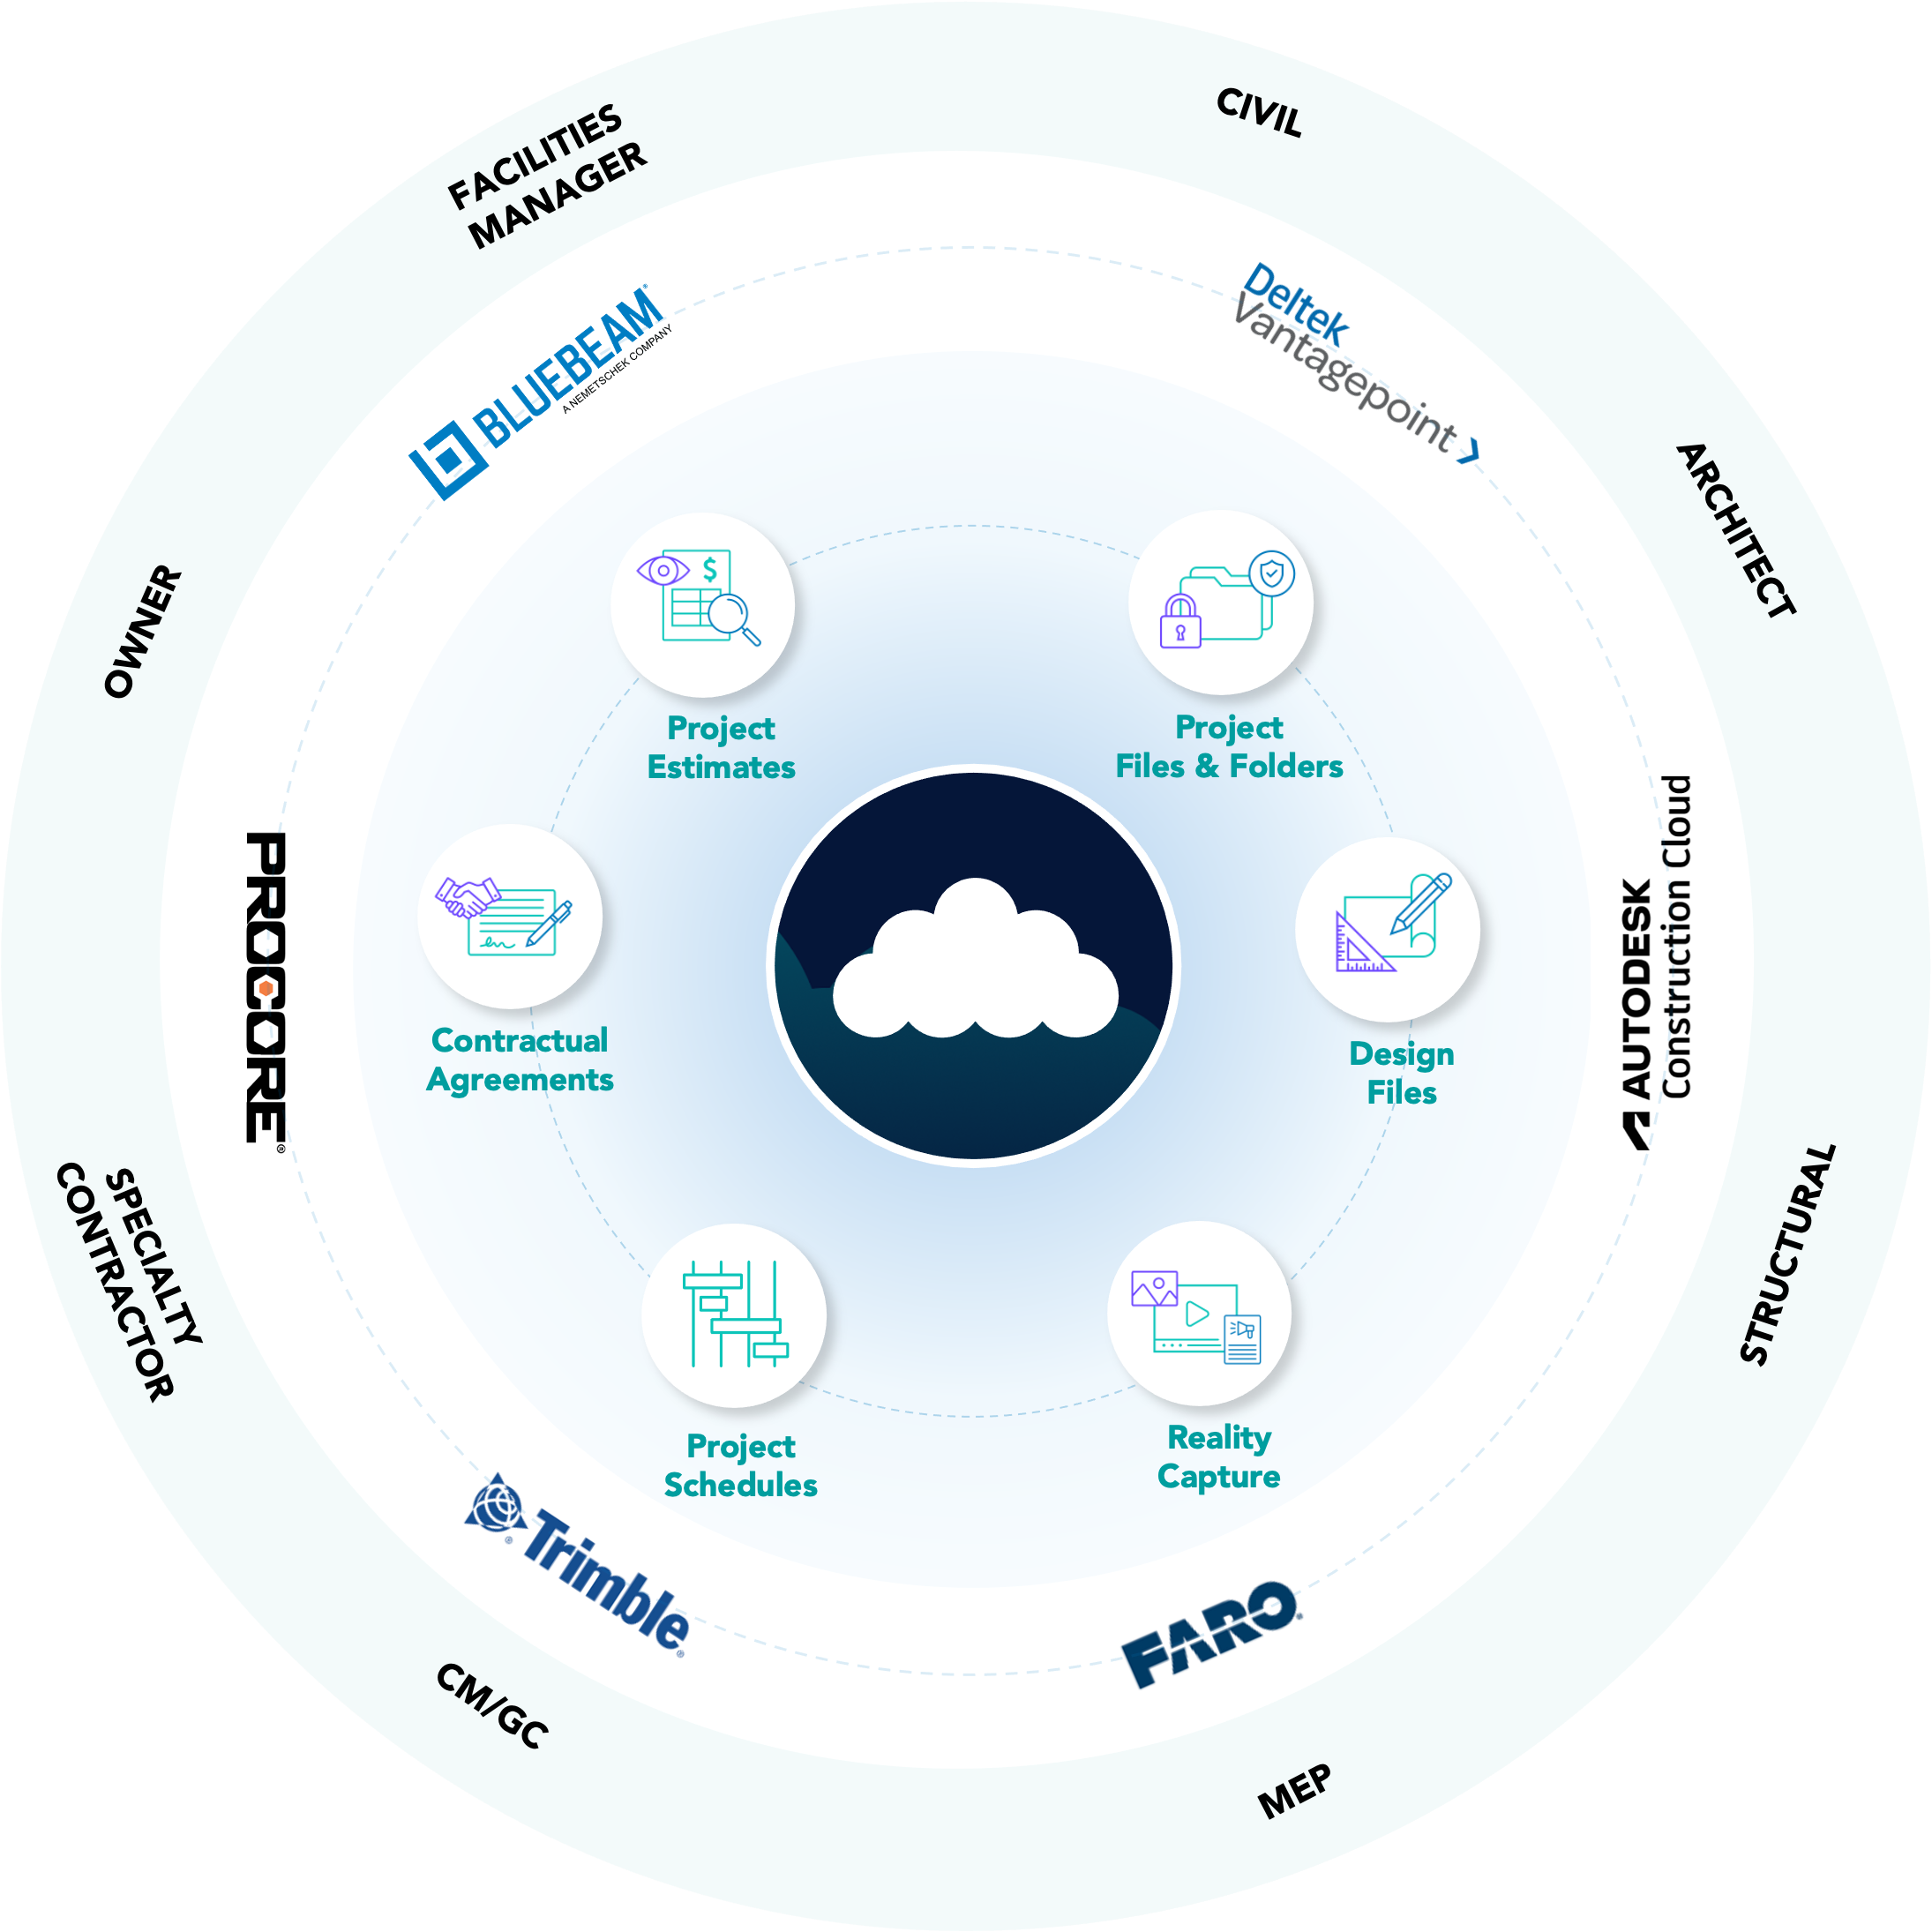


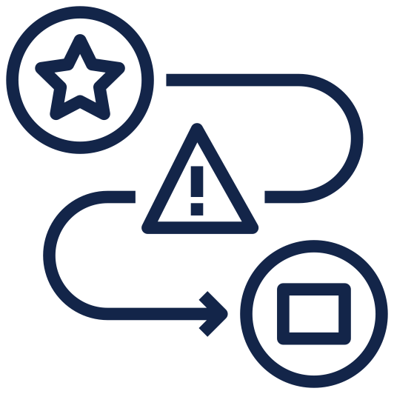




Step 2:
Build a Common Data Environment
FRAGMENTED DATA
CENTRALIZED DATA
Multi-Cloud +
Document Sprawl
Fragmented
Collaboration
Limited Access
To Project Files
Version
Control
Compliance Challenges
Data Security Concerns
Notes:
Joelle: Before you can use AI, you need clean, centralized data. That means files, scans, contracts—everything in one place, secured and searchable.

Slide 8
How can AI help firms to leverage knowledge from past projects?
Notes:
Neil: Quick gut check—how many of you feel confident your firm has a single source of truth for project data?
Joelle: What’s one task in your workflow that you wish AI could automate? Anyone want to share a roadblock you’ve hit?

Slide 9
Step 3:
Improve Efficiency by Applying AI to Your Data
Data In ➜ Classified ➜ Tagged ➜ Searchable ➜ Actionable
Notes:
Joelle: Once your data’s in order, AI can take over the busywork.
Think classification, version tagging, risk flagging. You’re not replacing humans—you’re freeing them up for high-value work.

Slide 10

Step 4:
Leverage AI to Maximize Data Security & Trust
Facilitate compliance with data protection regulations (e.g., GDPR, CPRA).
Guide your firm through ethical AI usage and adherence to international privacy and data security standards.
Utilize AI to manage routine security threats and to prevent phishing attacks.
Notes:
Neil: Security’s critical here. AI only works if the data is protected.
Enterprise AI respects your permissions and keeps your firm’s IP safe.
That’s the difference between public tools and enterprise-grade solutions.

Slide 11
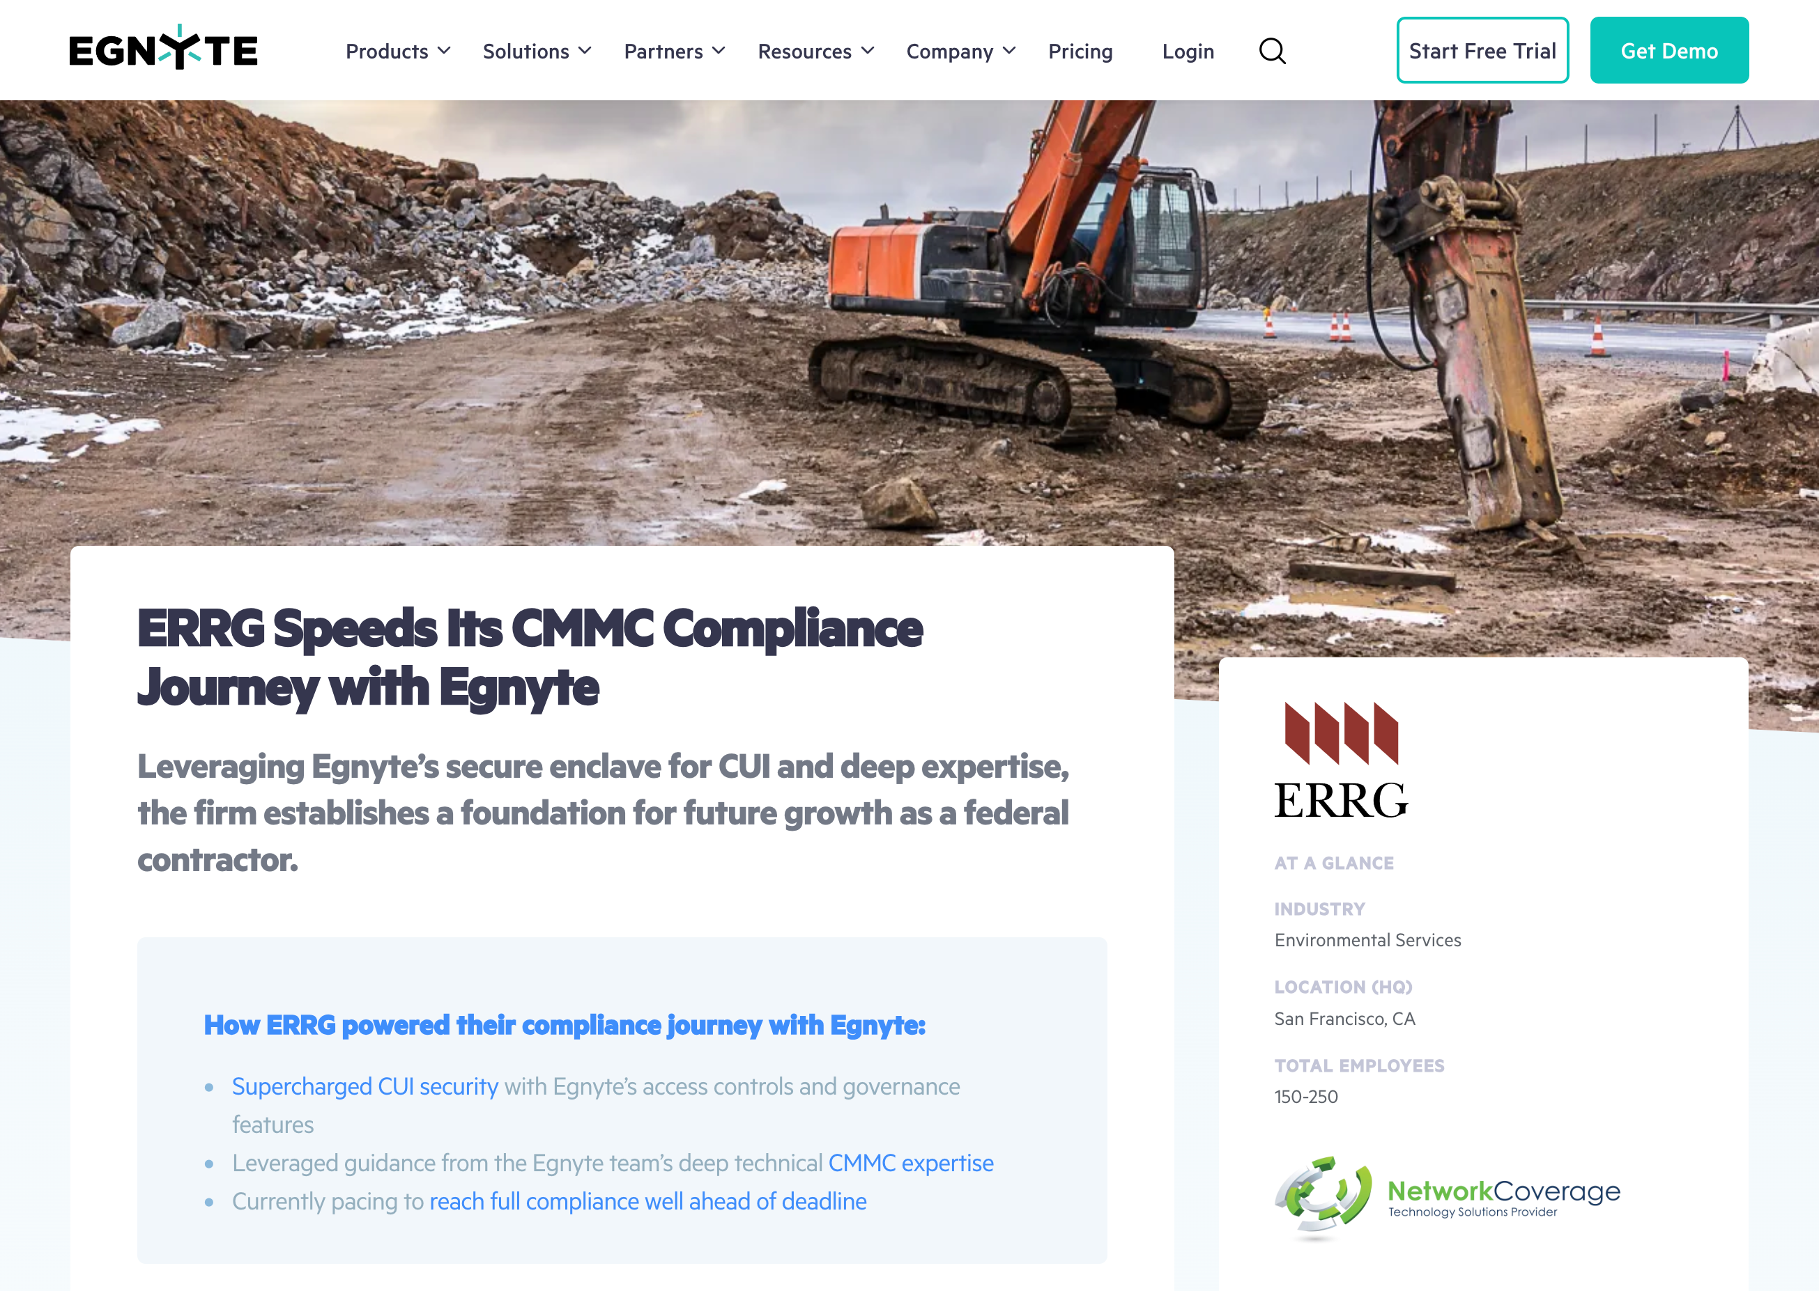

Customer Success: ERRG
“With about 80% of revenue coming from federal government contracts, we either get compliant with CMMC or cease to exist.”
- Brad Hall, VP, ERRG
Notes:
Neil: ERRG works in remediation—tons of partners, tons of risk.
With Egnyte, they centralized project data, and AI managed permissions and versioning. It helped streamline documentation and reduce compliance issues.

Slide 12
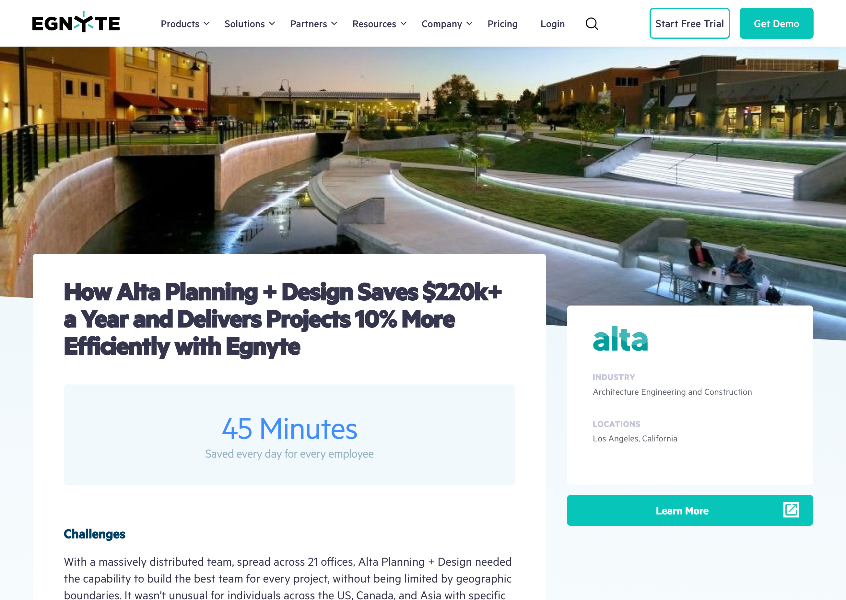

Customer Success: Alta
The average billable user saves at least 30 minutes a day because they are no longer hunting for files. This saves the business approximately $91,000 a year.
Notes:
Joelle: Alta’s design teams were decentralized.
They created a smart repository powered by AI search.
That gave them faster design cycles and better reuse of templates—real ROI.

Slide 13


Customer Success: Volkert
…Now we’re trying to focus more on actually using the technology to drive the company forward, as well…
- Phillip Carlisle, VP & IT Director, Volkert (Commentary linked here)
Notes:
Joelle: Alta’s design teams were decentralized.
They created a smart repository powered by AI search.
That gave them faster design cycles and better reuse of templates—real ROI.

Slide 14
What take-away from today’s session will you incorporate into your daily work?
Notes:
Neil: Let’s reflect for a minute—what’s one thing you’re taking away from today’s session?
Joelle: What’s one next step you can take? Would anyone here be open to joining a follow-up working group?

Slide 15
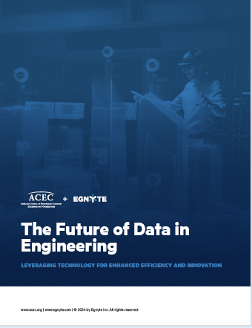

The Future of Data in Engineering
Notes:
Joelle:
Before you go, scan the QR code to get our whitepaper. We’d love to help your firm explore what’s next in AI.
It’s a useful framework for firms at any stage of their digital transformation.
Thank audience and set up Q&A.

Slide 16
Thank You!
Any Questions?

Slide 17
Back-Up Slide

Slide 18
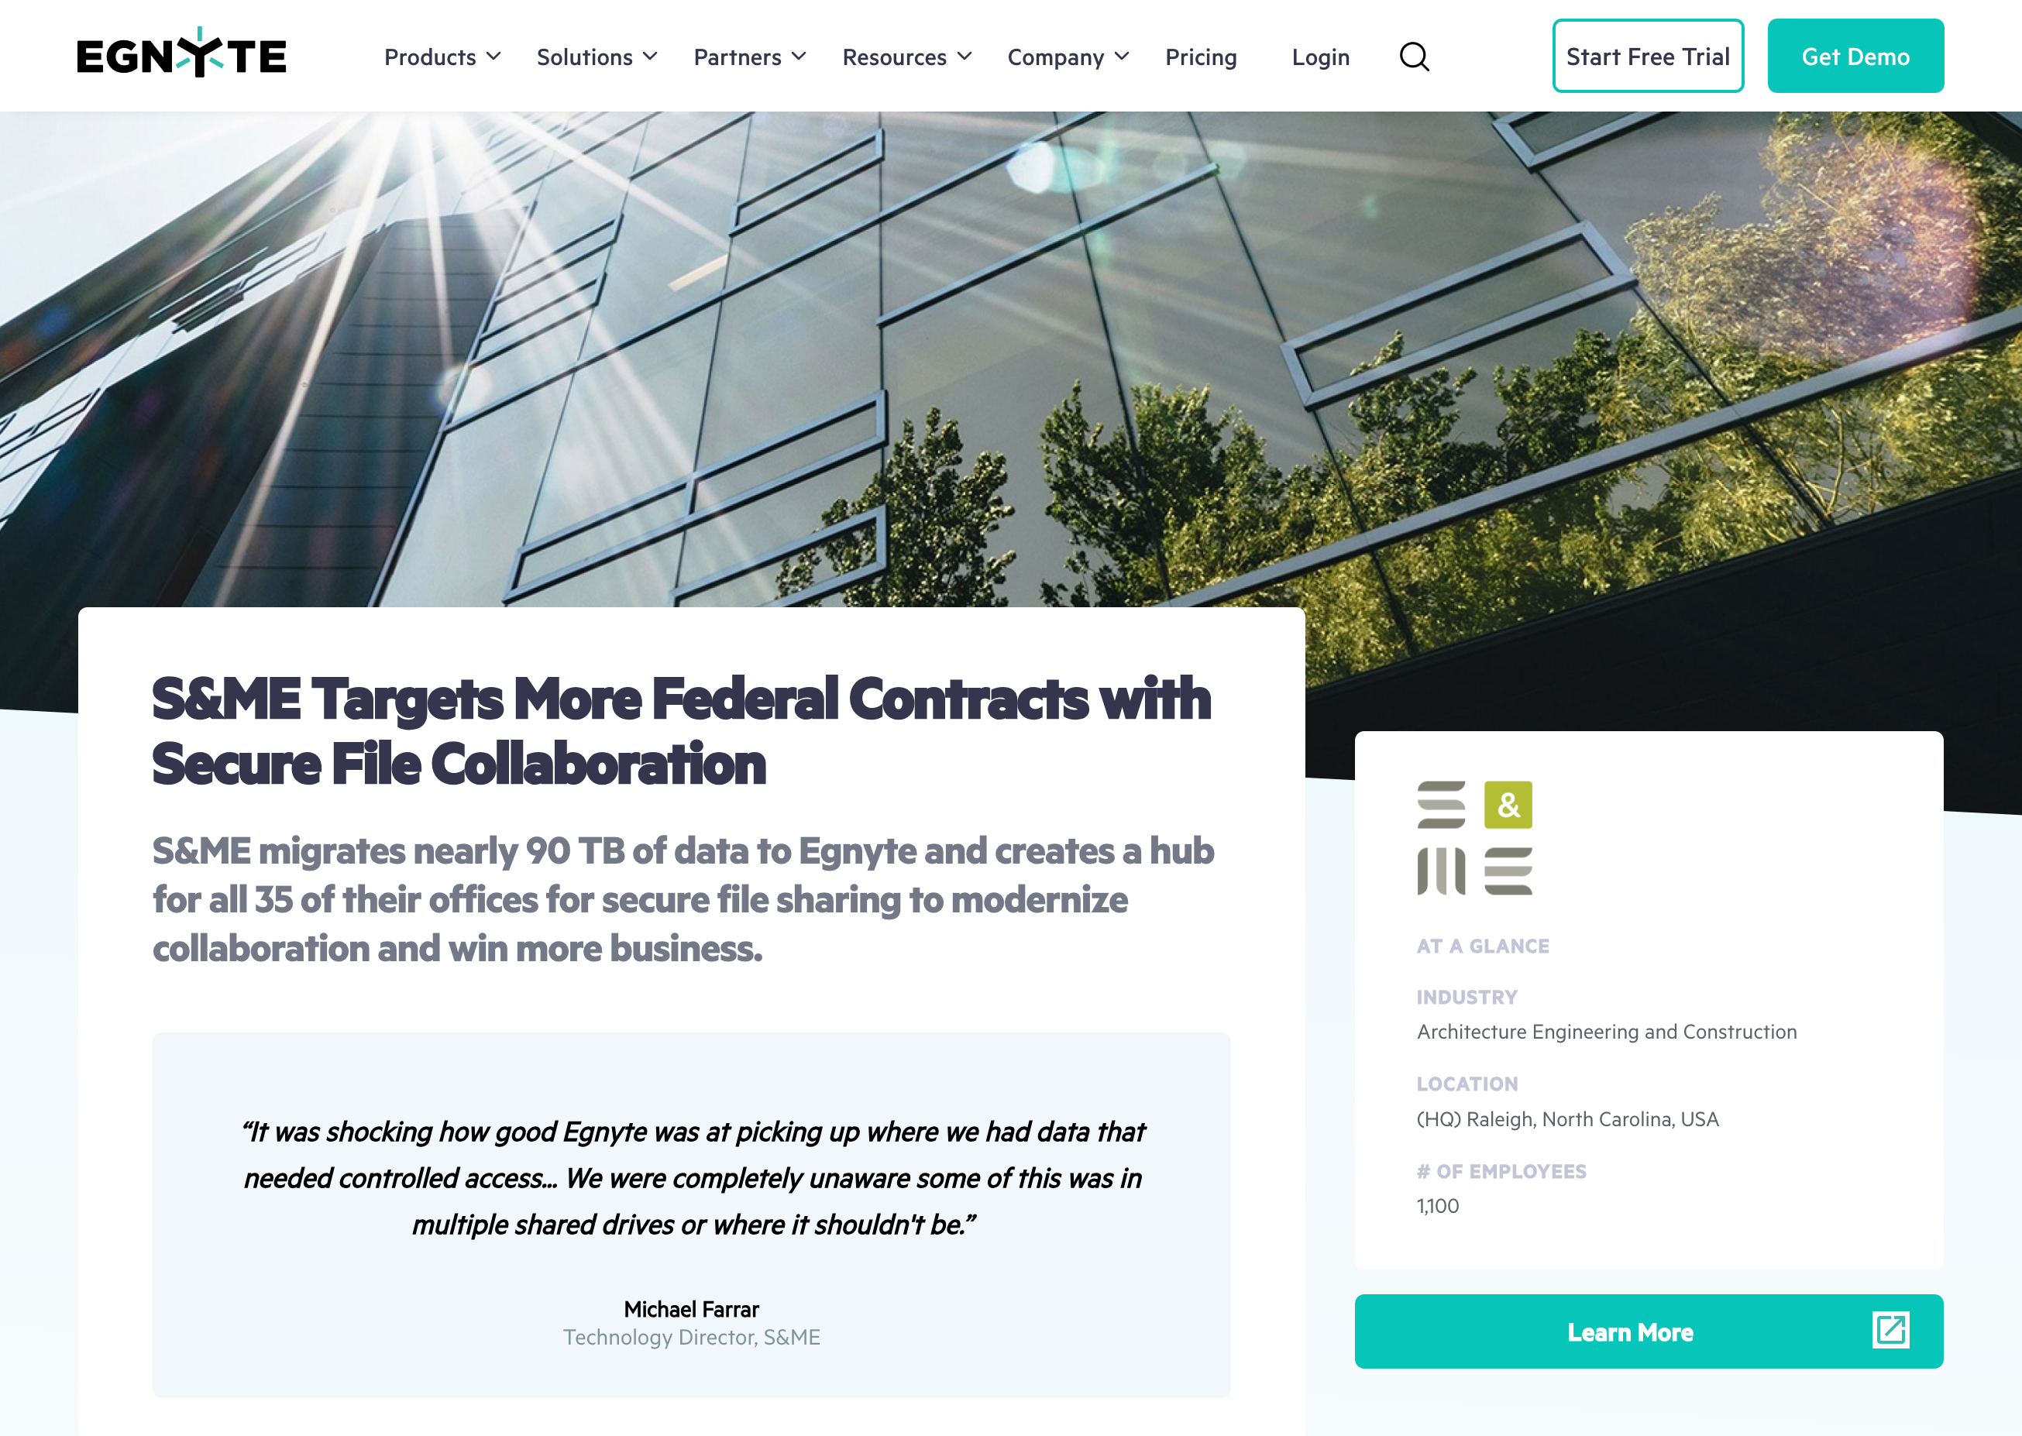

Customer Success: SME
Notes:
Joelle: SME had thousands of field reports. They used AI to organize and classify them by project type and location.
Suddenly, they could retrieve data quickly—and avoid liability from missed documentation.

